Slide 1


Brooks Secondary School
Soaring Strong Together
Grade 12
Information Package

Slide 2

Contents
Graduation Requirements Review
Dual Credit Programs
Life after Brooks
Planning for Post-Secondary
Transcripts
Scholarship & Bursaries
Student Loans
Tips for Parents

Slide 3
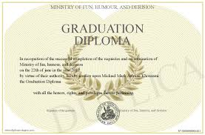
Graduation Requirements
Dogwood Diploma Criteria Set by Ministry of Education
80 credits from grades 10, 11 & 12 including
16 credits @ Gr. 12 level plus...
Career Life Connections Course
One Arts or Applied Skills Course taken in grades 10-12
Grade 10 Numeracy & Literacy Assessments plus Grade 12 Graduation Literacy Assessment

Slide 4

Academic & Trades Programs
DUAL CREDIT TRADES
Students have the opportunity to earn dual credits with VIU through several different trade programs. These include: Carpentry and Automotive.
DUAL CREDIT ACADEMIC COURSES
Brooks Secondary partners with our local VIU campus to allow high school students to take a university course for credit for free, while in Grade 12.
Please visit the counselling suite for brochures, more information and application packages.
Talk to a Career Pathways Coordinator for more information.

Slide 5

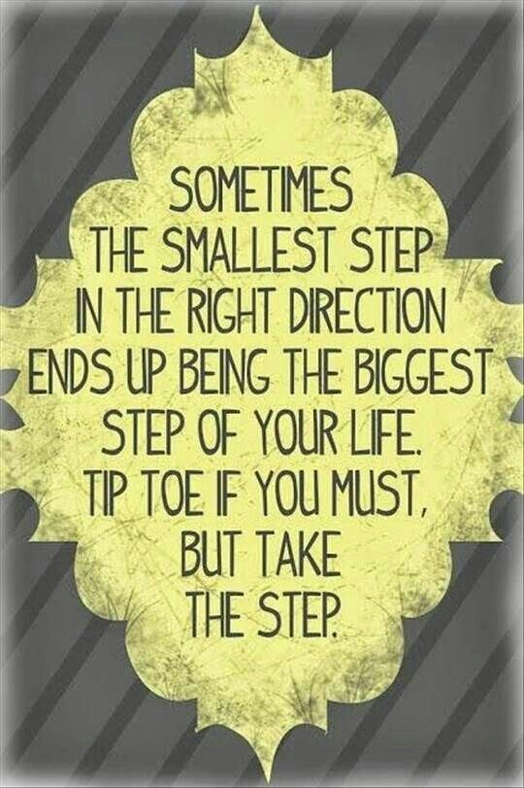
University or College
Work
Trades
Life After Brooks
Travel

Slide 6




Find a Job
Counsellor Tip:
Start saving some money for the future
Exploring different work environments and learning to support yourself are a big part of planning for your future

Slide 7


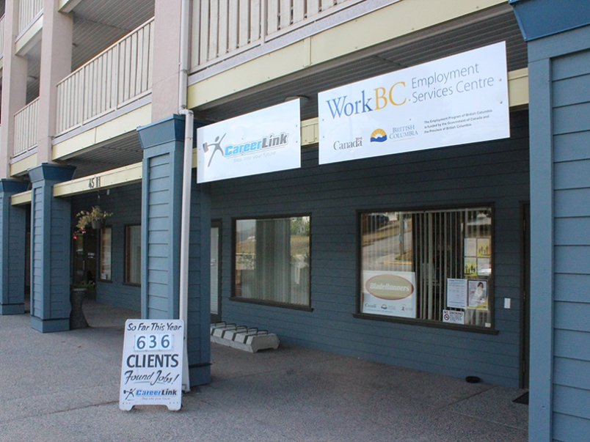

Explore local work opportunities at...
4511 Marine Ave
(604) 485-7958

Slide 8

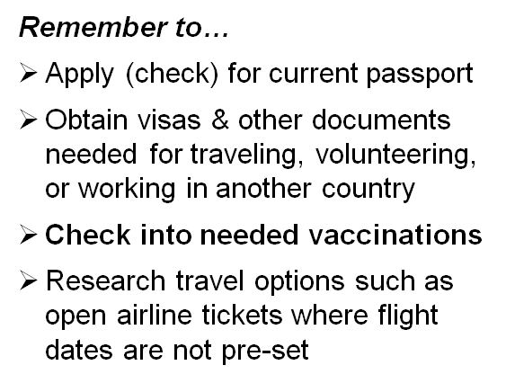
Going Travelling?
Counsellor Tip:
Parents, talk to your child about their travel plans. Make a list of potential risks associated with travel and develop a safety plan together.

Slide 9

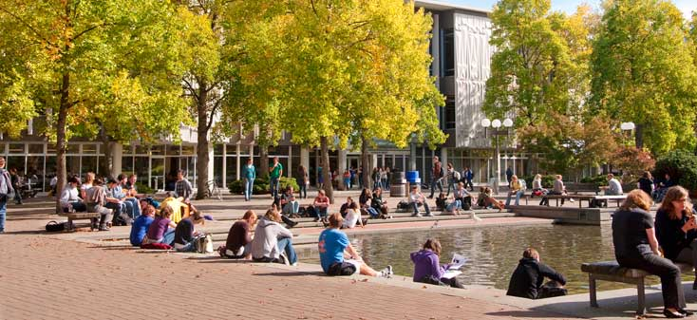
Planning for College, University
& other Post-Secondary Options

Slide 10





College
College Advantages:
Small class sizes
Individualized instruction
Cost savings (lower tuition, live at home)
Greater flexibility
More supports
Fewer entrance requirements

Slide 11




University Admission
Each university’s entrance requirements are different.
Be sure to check the general admission requirements as well as program entrance requirements and course pre-requisists.
These can be found online with Education Planner or each insitutues webpage and Viewbook.

Slide 12

Important
Graduation Requirements
do not necessarily equal
College or University Admission Requirements

Slide 13
Grade Requirements
Each institution sets their own minimum entrance GPA
67% to 85% is a typical general admission average
Minimum GPA changes year to year and program to program based on the pool of applicants and seats available.
Some programs, like nursing, engineering have competitive entry.
Others, like music, require auditions.

Slide 14

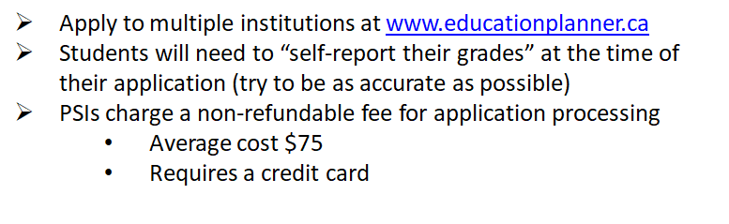

How to Apply

Slide 15

PSI Application Deadlines vary from institution to institution and sometimes by program – double check your program.
School | Important Dates
UVIC | OPENS in September and closes January 31 (program dependent).
UBC | OPENS in October and closes Jan 15 (program dependent).
TRU | OPENS in October and closes May 1, (program dependent some as early as Jan 15), trades program applications are accepted throughout the year.
VIU | OPENS in early October and deadlines vary by program.
BCIT | OPENS October 1, most program applications are ongoing throughout the year and close when programs are full (check your program).
Staying on Campus?
Housing for first year students is typically guaranteed but don't forget to apply for it once you are accepted!

Slide 16
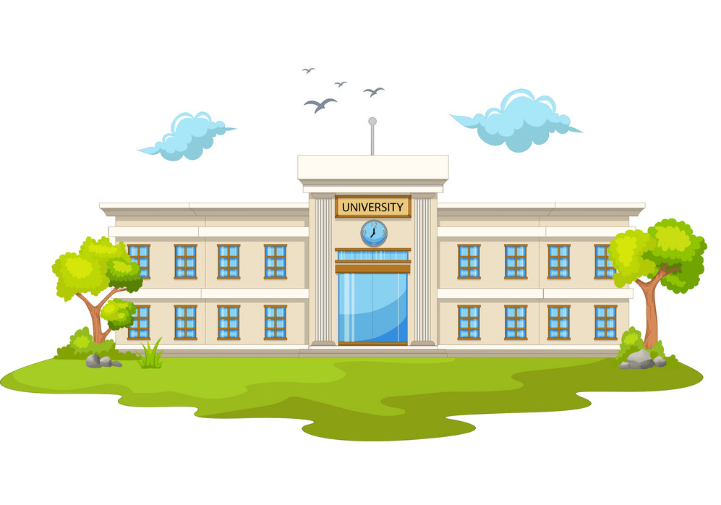
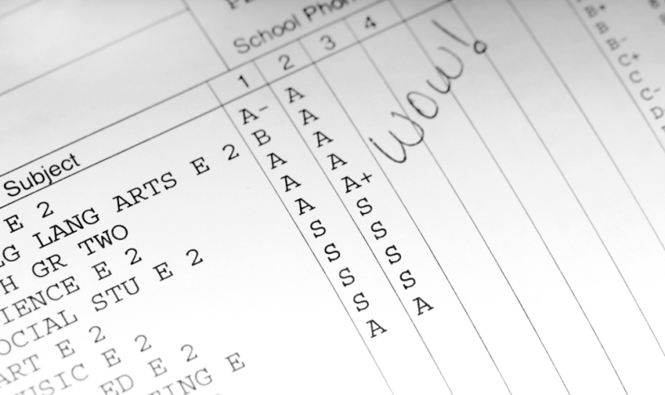
How Do I Get My Transcripts to the PSIs?

Slide 17

Important Information
PSI's now require ELECTRONIC Transcripts to be sent through student BCeID ACCOUNT
Step 1: Got to www.StudentTranscripts.gov.bc.ca
Step 2: Sign up for a BCeID (use your personal email – check your junk mail)
Step 3: Log-in to Student Transcript Service using your BCeID
Step 4: From your Dashboard, chose the post-secondary institutions to send transcripts to, send and order transcripts, view exam and assessment results and view scholarship information.
Some institutions also require paper copies of transcripts. PSI's will let students know via email and/or a mailed letter
StudentTip: Check for and read all emails from PSI's closely. Often PSI's request/require specific additional information to be mailed or submitted electronically.

Slide 18

Q: How Can Students Print/View Their Unofficial Transcript?
A: By using MyEd Portal or a BCeId Account.
Create Your BCeID Account:
Google "Student Secure Web"
Create a BCeID Account using your PEN Number
See an academic advisor or counsellor
A PEN is your Personal Education Number, located at the top of all report cards.

Slide 19

.
Scholarships & Bursaries

Slide 20
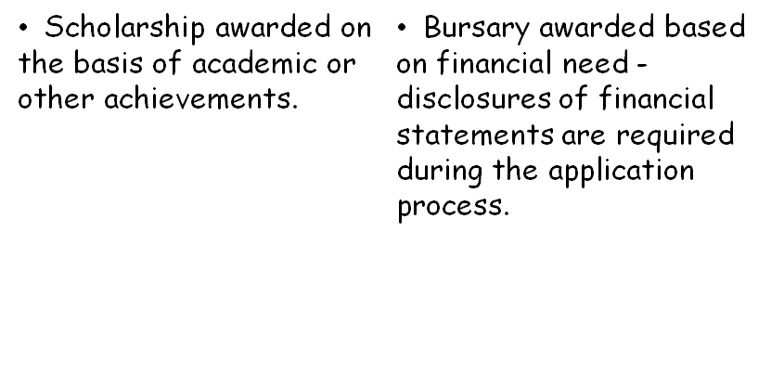

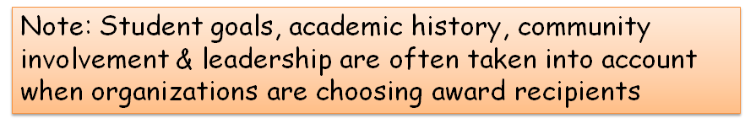
What's the Difference?

Slide 21


Local Scholarship Opportunities
The Common Scholarship Application
One application for all local scholarships/bursaries
Applications available in March from Brooks office
District Authority Scholarships
Opportunity to recognize student achievement in the following areas:
Applied Design, Skills, and Technology
Community Service (Volunteer Activity)
Fine Arts
Indigenous Languages & Culture
Languages
Physical Activity (and Health)
Technical and Trades Training
For more information:
https://www2.gov.bc.ca/gov/content/education-training/k-12/support/scholarships/provincial-scholarships

Slide 22

PSI Entrance Scholarships
Institution specific
Selection based on grade and possibly one or more of the following:
Reference letters
Nominations
Scholarship essay
Community involvement
Application Process
There is typically a separate Online Application for Entrance Scholarships. You should apply for these when you apply to the school(s) of your choice
Or some cases (like UBC) application occurs automatically with PSI acceptance

Slide 23



Scholarship Tips
Inquire with the organizations to which you or extended family members belong (work, clubs, associations etc.). These may offer scholarships & bursaries to members!
Ask teachers/coaches now to write you letters of reference and keep them on file
Apply! Apply! Apply!
Inquire!
Ask!
Loads of scholarships do not get awarded each year because no one applies for them!

Slide 24


Student Loan Options
Canada Student Loans & B.C. Student Loan Programs
Interest Free Loans
Repayment begins 6 months after completing a full program
See websites for more details
Student loans Canada and BC

Slide 25

Post-Secondary Planning
Tips for Parents
Keep an open mind about where your child is thinking of attending.
Talk to other parents who have already gone through the process.
Do some online research of post-secondary institution reviews with your child
Help your student consider options and complete PSI applications
Have an honest conversation about how much you can afford to pay and how much money needs to come from other sources: scholarships, bursaries, student loans, and/or your child's part-time job.

Slide 26

Get Organized!
Keep a binder or folder for post-secondary, scholarship, and student loan information
Schedule time each week to work on PSI related tasks
Get a social insurance number (SIN)
Write down your PEN (Personal Education Number)

Slide 27
Conclusion
Enjoy your Grade 12 year
Study, work hard and maintain a good GPA
Research and plan for life after high school
Stay calm and focus on your goals
and when in doubt...
Make an appointment to speak with an academic advisorm counsellor or career pathways coordinator.

