Slide 1
Choosing Courses for Grades 10-12 Feb 2026
Brooks Secondary School

Slide 2
Course selection
Course selection information sessions will take place Feb 2rd to Feb 10t^{h}
Students will complete the course selection form in class, any missing students need to come to counselling suite ASAP to complete!

Slide 3
Why is Course Selection So Important?
Not all courses in the Course Selection Handbook will be offered. Insufficient enrolment will result in courses being cancelled.
Pick alternates!

Slide 4
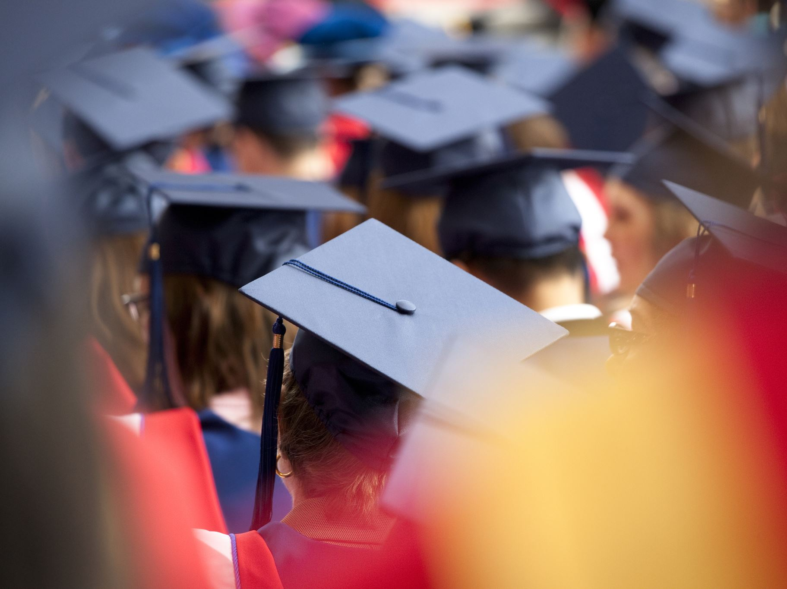
The Graduation Program

Slide 5
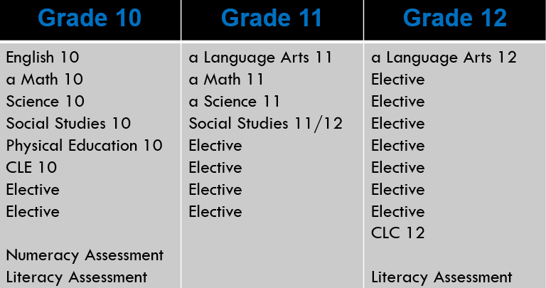
Required Courses for Graduation
All students must take one Indigenous Focused Education class prior to graduation. This may be English First Peoples, B.C. First Peoples or an ayajuthem class taken at the Grade 10,11 or 12 level

Slide 6
Required Courses for FI Graduation
Grade 10 | Grade 11 | Grade 12
-English 10 -Math 10 -Science 10 -Social Studies 10 -Physical Education 10 -CLE 10 -FRAL 10 -Elective -Numeracy Assessment -Literacy Assessment | -Language Arts 11 -Math 11 or 12 -Science 11 or 12 -Social Studies 11or12 -Langue et culture de la francophonie 11 -Communication Orale 11 -Elective -Elective | -Language Arts 12 -FRAL 12 -Elective -Elective -Elective -Elective -Elective -CLC 12 -Literacy Assessment -Evaluation de litteratie de la 12e annee

Slide 7
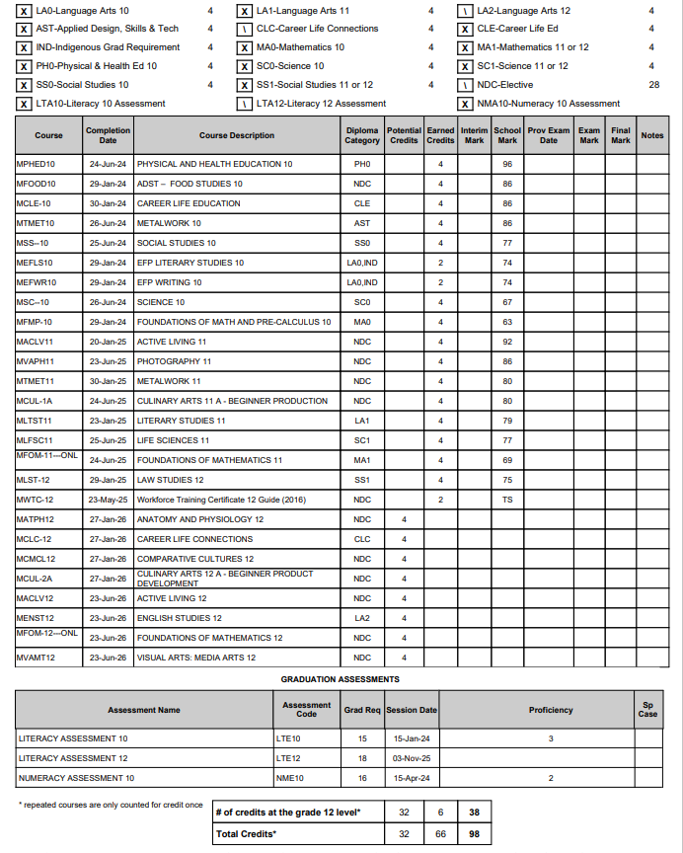

Slide 8

In addition to the required courses, students must also complete three graduation assessments:
The Grade 10 Numeracy Assessment
The Grade 10 Literacy Assessment
The Grade 12 Literacy Assessment
An Indigenous Focused Education course in either Grade 10, 11 or 12. This can be any of English First Peoples, B.C. First Peoples or ayajuthem.
***For French Immersion or Francophone students, please ensure you have taken Careers 10 in French; if you have not, this must be one of your elective choices this year
Additional Graduation Requirements

Slide 9

Considerations
A full timetable is 8 courses per year.
Students are encouraged to take a wide variety of courses and to challenge themselves…be open to new opportunities!
Grade 11 Students
Must take 8 courses
Grade 12 Students
Must ensure their credits for graduation
May request a study block after 80 credits have been completed
If planning to be part time, students must complete a separate application

Slide 10
SELECTING COURSES

Slide 11
What Do I Need to Think About?
The elective courses and programs that you would like to take at the high school level
some courses/programs require a separate application (ex. School Service and Leadership 11/12, Recreation Management 11/12, IDS, WEX, GIJE, YWT, Trades Sampler and Dual Credit)
The programs available at various post-secondary institutions that you might be interested in
it’s okay not to know exactly what career you want to have
it is important to think about the possibilities and start planning for them
most post-secondary programs have high school prerequisites

Slide 12

What Do I Need to Think About?
Research Math requirements for various programs and post-secondary institutions:
Workplace Mathematics 11 or Apprenticeship Mathematics 12
Foundations of Mathematics 11/12
Pre-calculus 11/12
Calculus 12
It is recommended to have a C+ in FMPC 10 prior to taking Pre-Calculus 11
Research other requirements for various programs and post-secondary institutions:
Courses required for a particular field of study
Second language requirements – Language 11
*Note: Creative Writing 11 and 12

Slide 13
Social Studies COurses
Grade 12 level courses are recognized as Academic 12 for Post-Secondary Admission
Explorations in Social Studies 11
Francophone History and Culture 11(FRIM Students)
B.C. First Peoples 12
Comparative Cultures 12
Comparative World Religions 12*
Law Studies 12
Philosophy 12*
Physical Geography 12
Social Justice 12*
20th Century History 12
Contemporary Indigenous Studies*

Slide 14
Science Courses
Grade 12 level courses are recognized as Academic 12 for Post-Secondary Admission
Chemistry 11
Environmental Science 11
Life Science 11
Physics 11
Science for Citizens 11
Anatomy and Physiology 12
Chemistry 12
Environmental Science 12
Physics 12

Slide 15
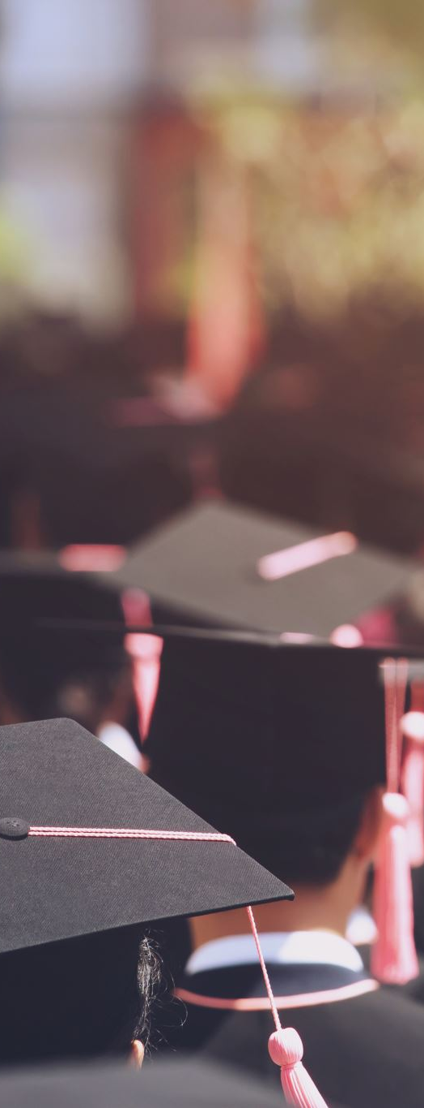
Graduation requirements vs PSI admission requirements
Please remember:
Every PSI may have different pre-requisites, please check all institutions carefully!
Seek help if you want support with this.
**TIP: call an admissions officer or recruitment officer at the PSI of your choice

Slide 16

Post-Secondary Considerations - BC
PSIs– May require up to 6 Grade 12 level courses as part of your admissions portfolio.
For some institutions like UBC: A Literacy 12 Assessment score of 3 may be required, and a second language to Grade 11 is no longer required – Sept 2026.
Please check each degree program for specific requirements, PSI’s may be easing up on entrance requirements, but the competition for entrance is not changing!
Check and double check your PSI’s pre-requisites!

Slide 17
Post-Secondary Considerations Part 2
Academic Courses Include:
20th Century World History 12, Anatomy and Physiology 12, BC First Peoples 12, Calculus 12, Chemistry 12, Comparative Cultures 12, Comparative World Religions 12, English First Peoples 12, English Studies 12, Environmental Science 12 , Foundations of Math 12, Français Langue Première 12, French 12, Law Studies 12, Physics 12, Philosophy 12, Physical Geography 12, Pre-Calculus 12, Social Justice 12

Slide 18

Other Specialty options
Course | Duration:
Hairdressing-career prep Gr 11/12 | Four full days a week – one sem
*Trades sampler | Half day, one semester at Brooks
GIJE | Four and a half days per week
Hockey Academy | One semester for Gr 9-12
Active Living 11/12 – Girls | One blk/one semester
Outdoor Education 12 | Half days/one semester
Guitar 11/12 | One blk/one semester
Film & AV Production | One blk/one semester
Care Economy Sampler 12 | One blk/one semester

Slide 19
Dual Credit
English 115 + Eng 12 @ Brooks – will run for a half day
ECEa130 + CLC12 @ Brooks – 8 credits/one block
Auto Mechanics: Sept-June
Carpentry: Sept-April
Early Childhood Educator
Health Care Assistant: Sept-March
Dual Credit Academic Courses and Programs: VIU, NIC, Camosun (max 2 courses):
Sept and Jan intake (must apply prior to April 3, 2026)

Slide 20
ONLINE RESOURCES

Slide 21
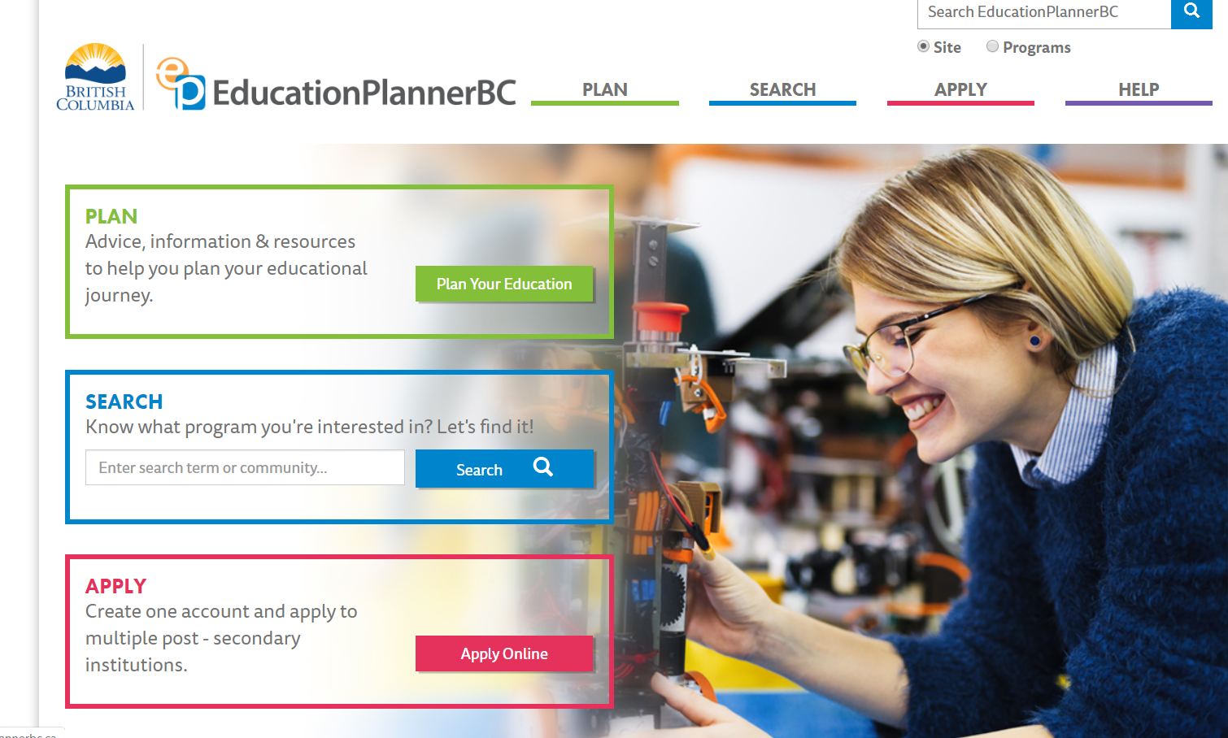

Slide 22
Course Handbook
The Course Handbook and more information about the course selection process are available on the Brooks website:
https://www.sd47.bc.ca/brooks/academic-advising-1

Slide 23
School Counsellors and Advisors
Mrs. Maxwell (A-K) Elaine.Maxwell@sd47.bc.ca
Mrs. Massullo (L-Z) Andrea.Massullo@sd47.bc.ca
Mrs. Ellis - Academic Advising and Dual Credit Pathways Coordinator Pam.Ellis@sd47.bc.ca
Mrs. Carlson - Career Pathways Coordinator (Trades Specific) kerri.carlson@sd47.bc.ca

Slide 24
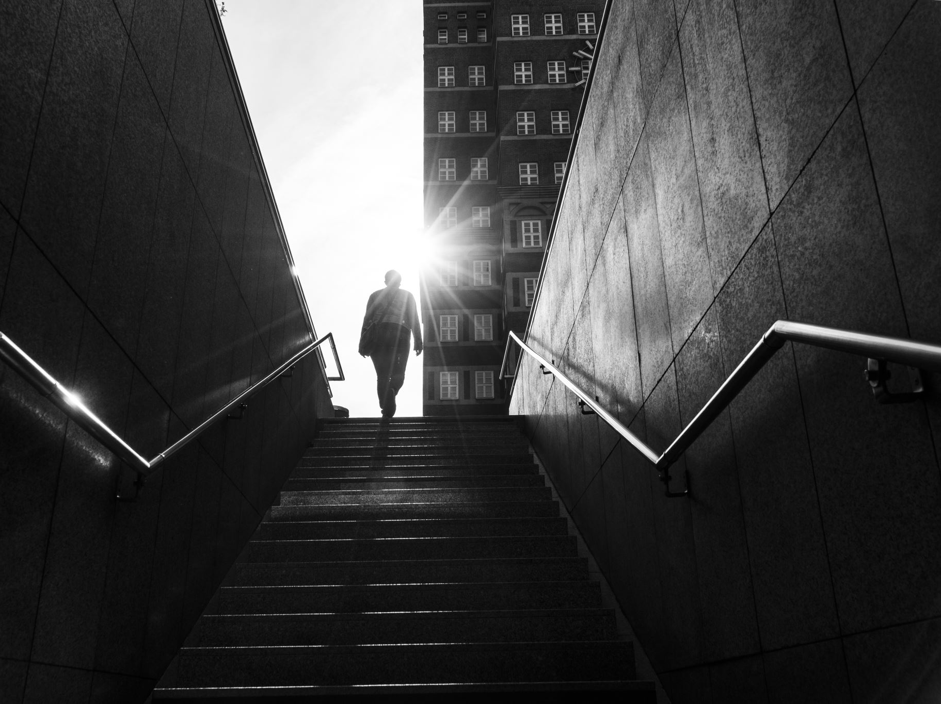
Final thoughts/Questions

