Slide 1

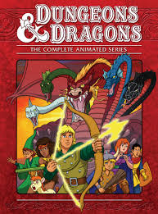
Dungeons
&
Dragons
The Adventure

Slide 2
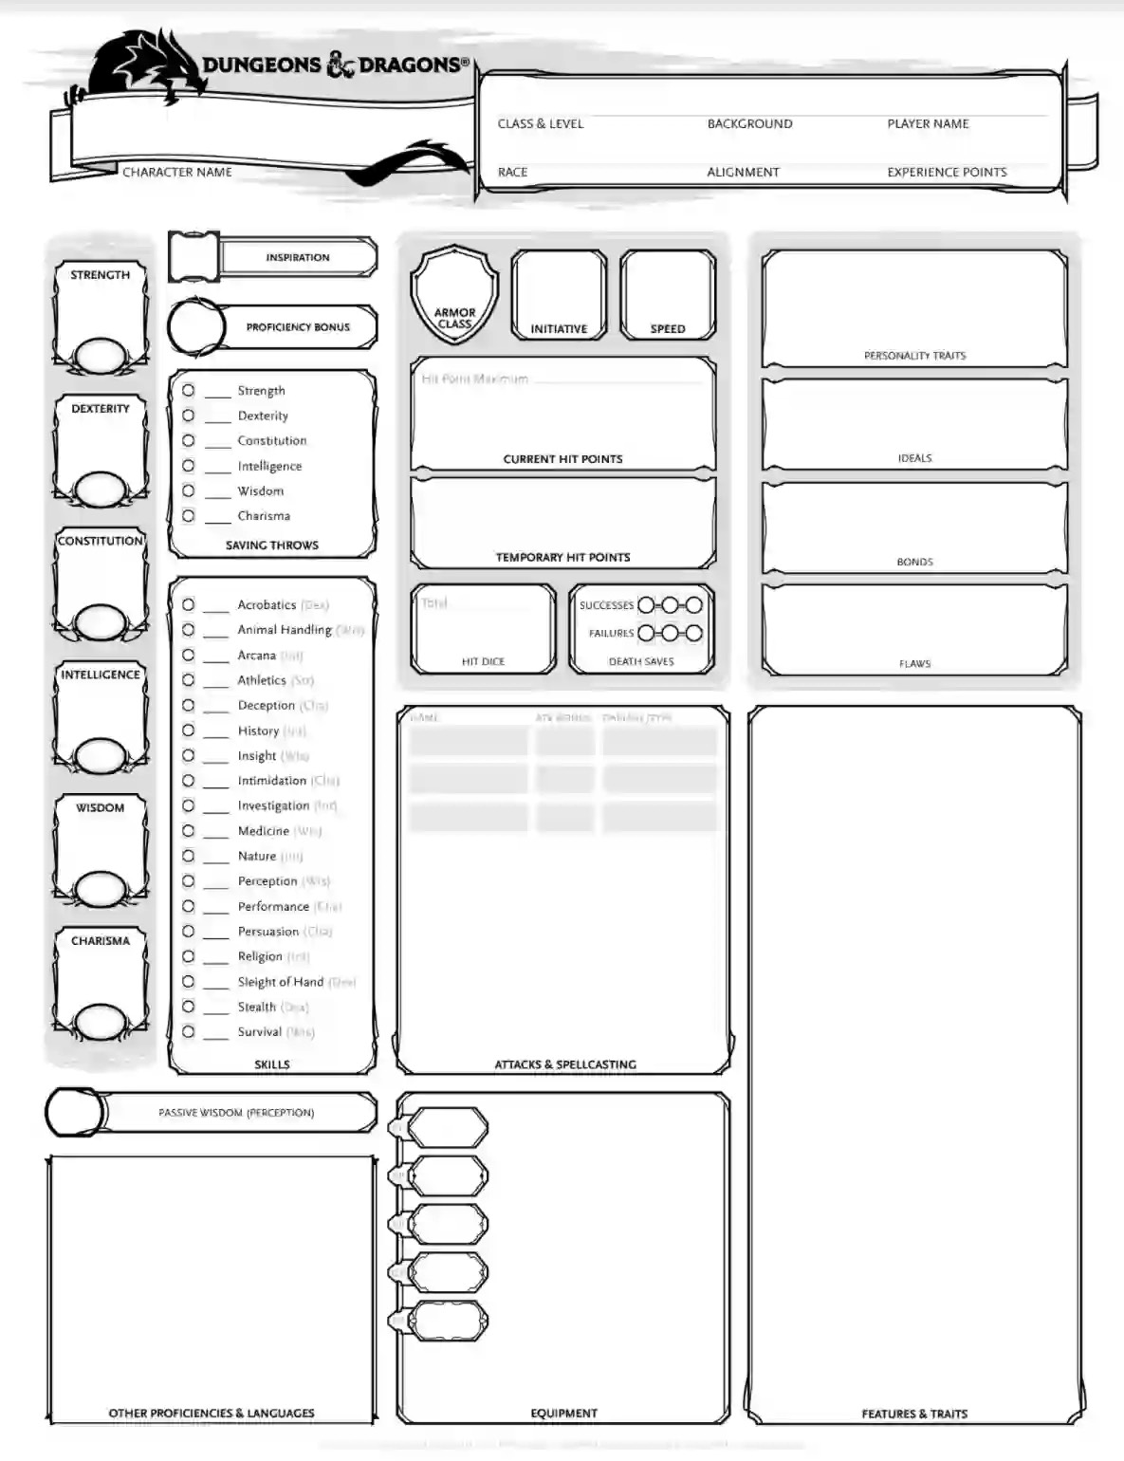
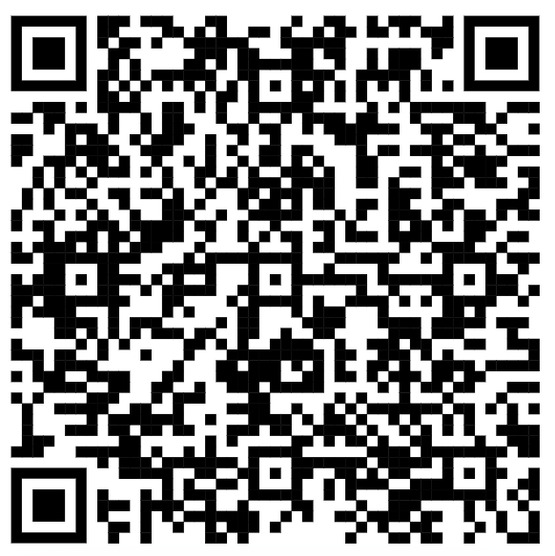

Slide 3
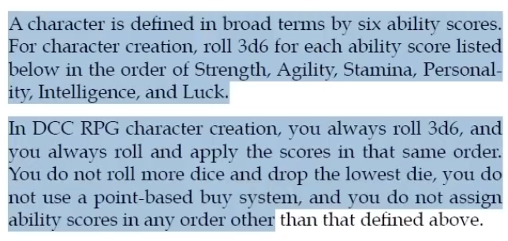
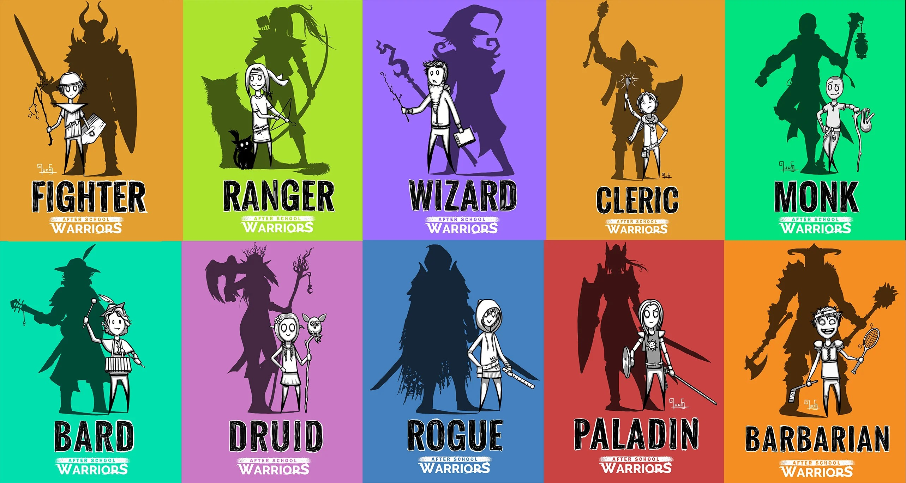
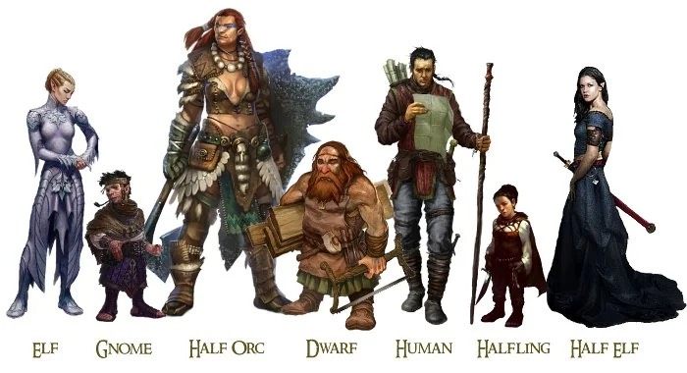
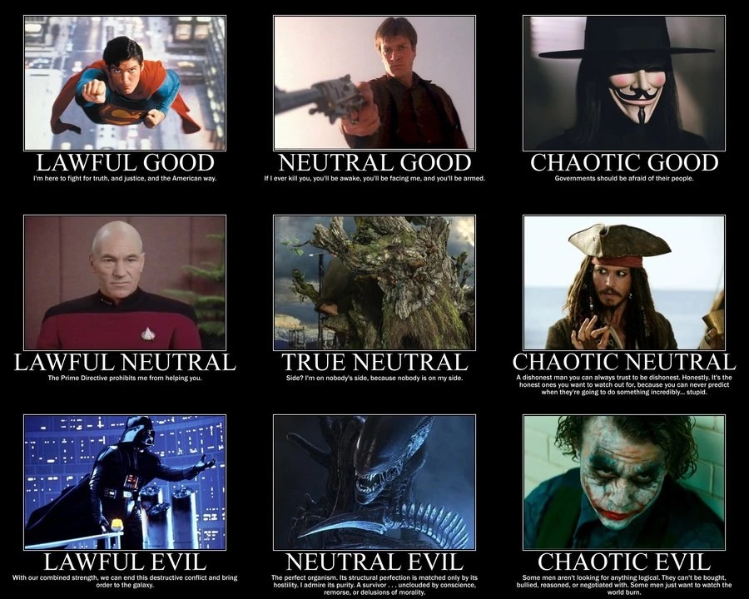
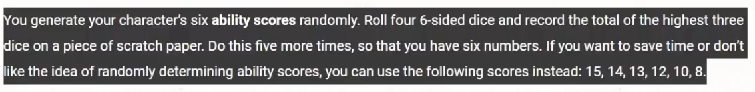
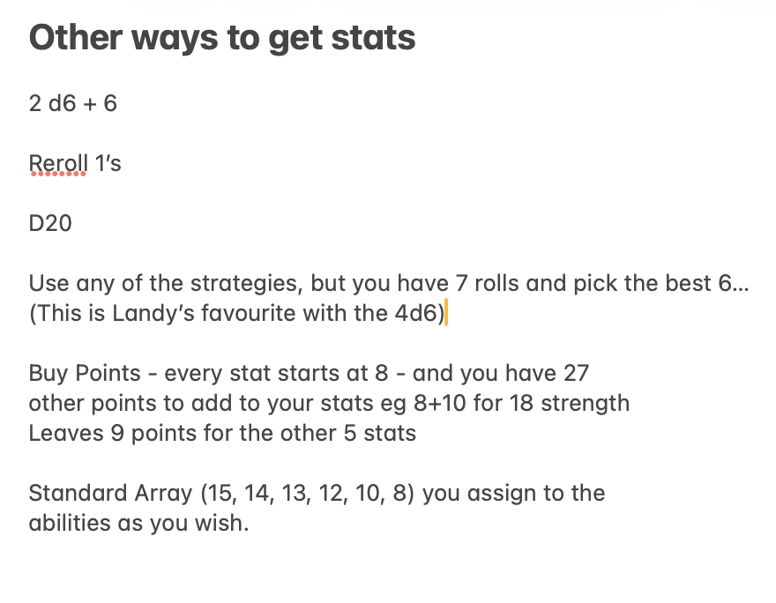
How to build a character…
Race:
Class:
Alignment:
NAME:
Strength; Dexterity; Constitution Intelligence; Wisdom; Charisma. /18
Armour Class:
Hit Points:

Slide 4
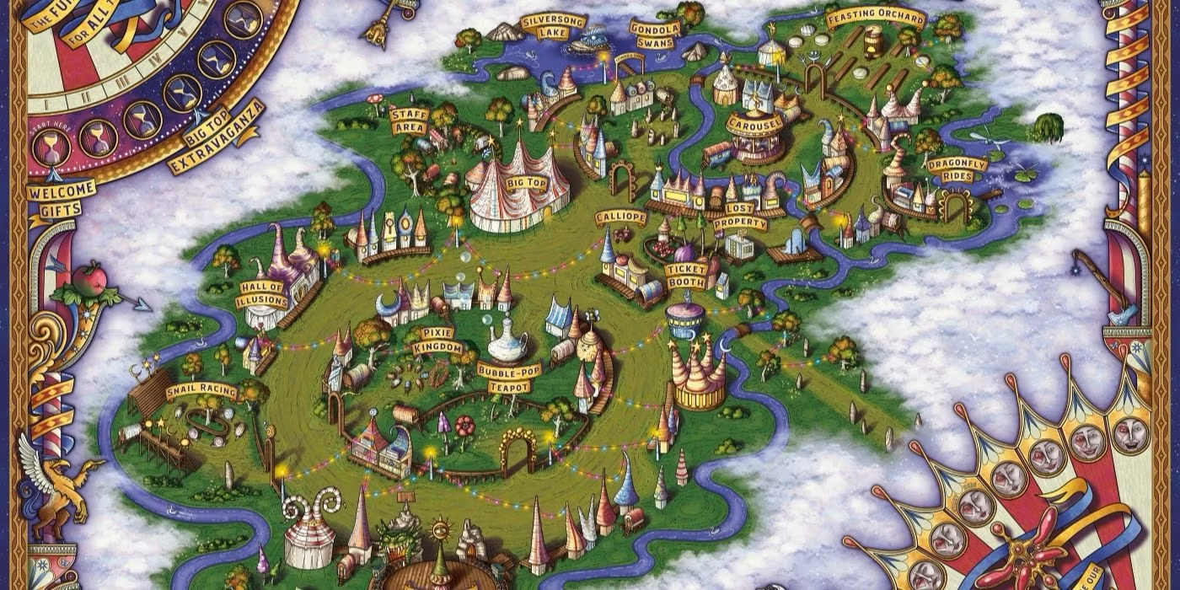
The Eye of the Pyramid
You are at the annual Riverlands Fair. When you hear a voice call out…

Slide 5
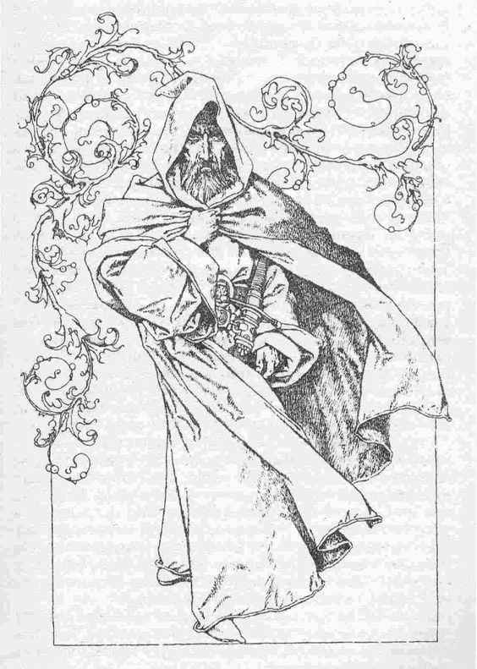
I have needs of brave adventurers.
The quest: go to Castle Datranto
There is a green emerald that I need for a spell… There is of course some danger…

Slide 6
Getting to the castle…
Via the trail…
Via the river…

Slide 7
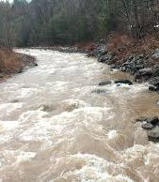
The River
Roll your dexterity…

Slide 8
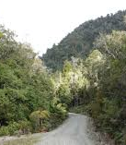
Wilderness Trail
What’s that sound?
Go off the trail?
Ignore the sound…

Slide 9
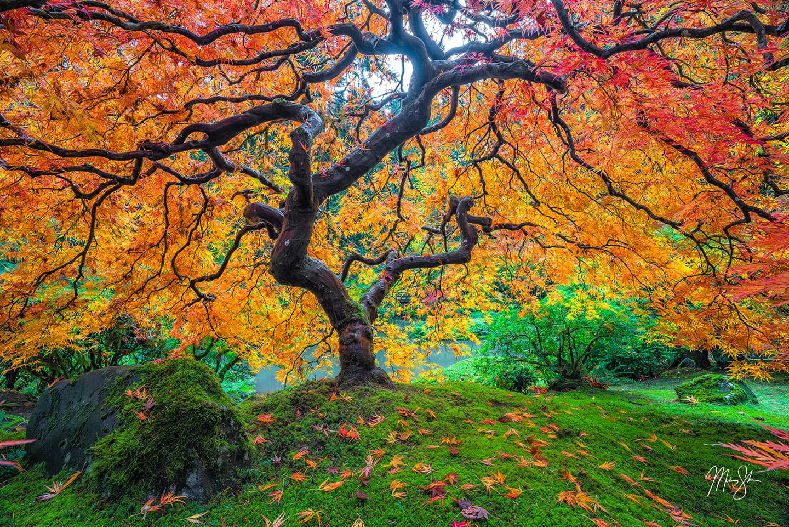
Run away!
Get ready for what’s coming!

Slide 10
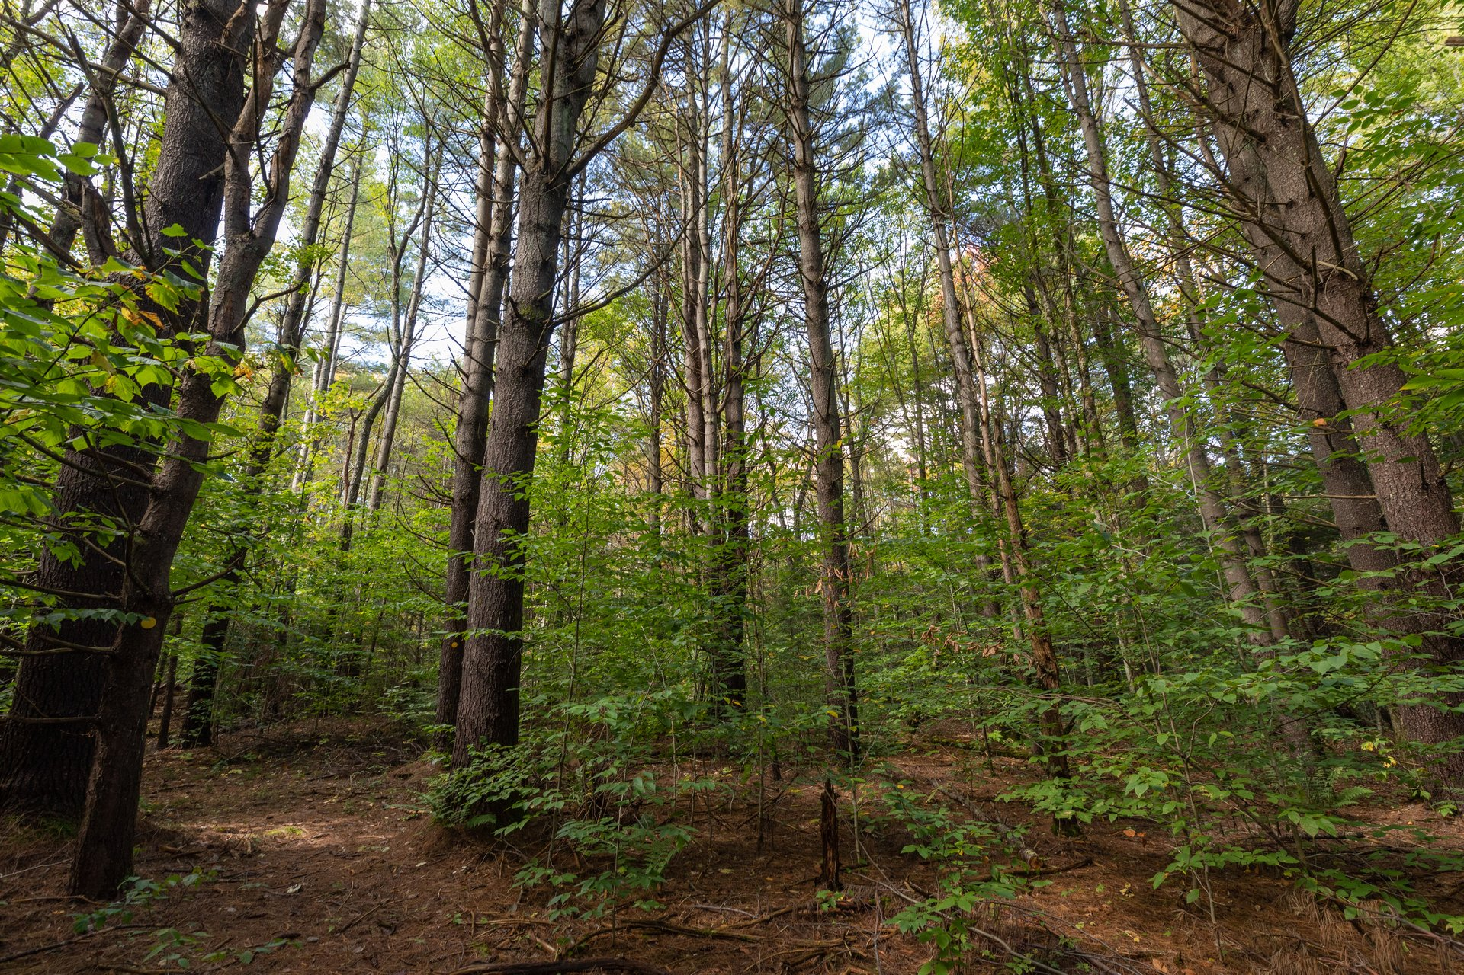
Keep Going Forward?
Go back and investigate that sound

Slide 11
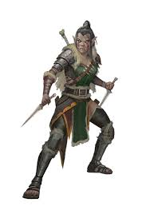
ORCS!! They’re blocking your escape!
Success!

Slide 12
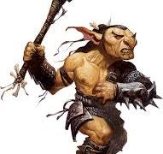
Goblins!

Slide 13
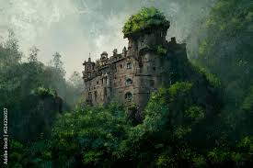
You see the castle!!

Slide 14
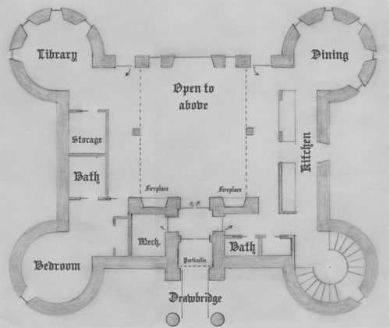
Library
Dining
Bedroom
Tower
Exit

Slide 15

Back

Slide 16
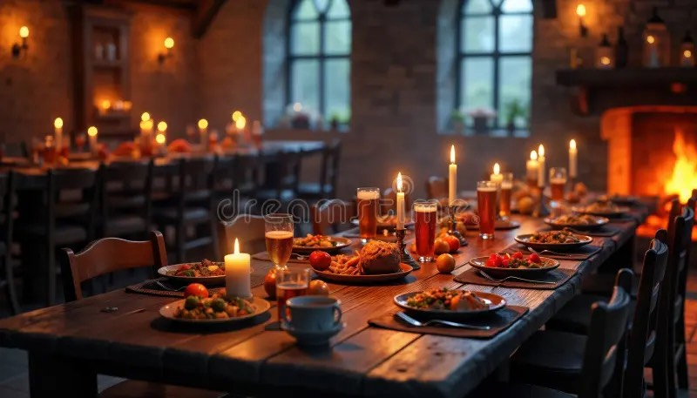
Back

Slide 17
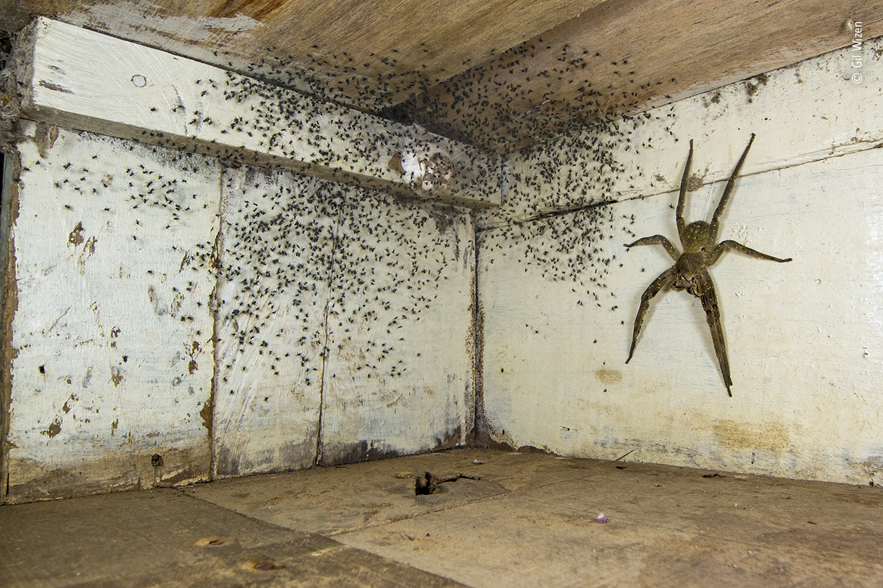
Back

Slide 18
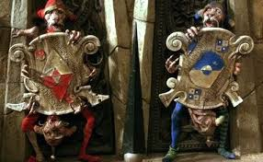
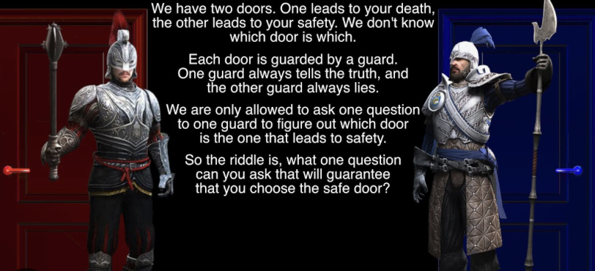
Red Door
Blue Door
Back

Slide 19

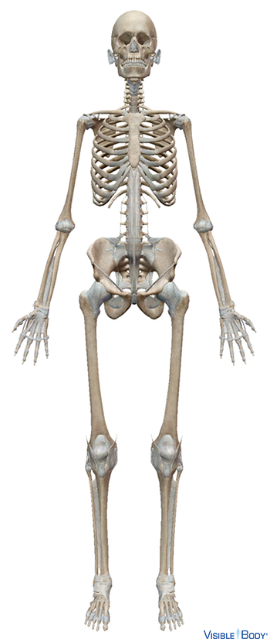

Slide 20
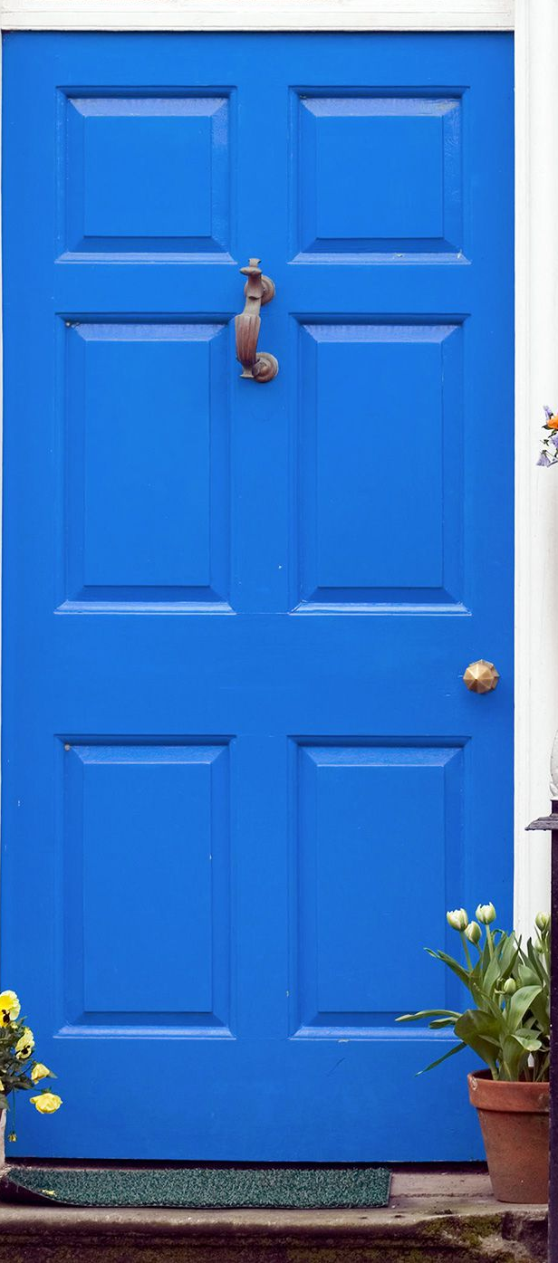


Slide 22
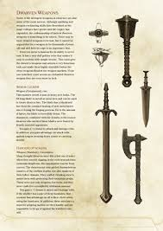
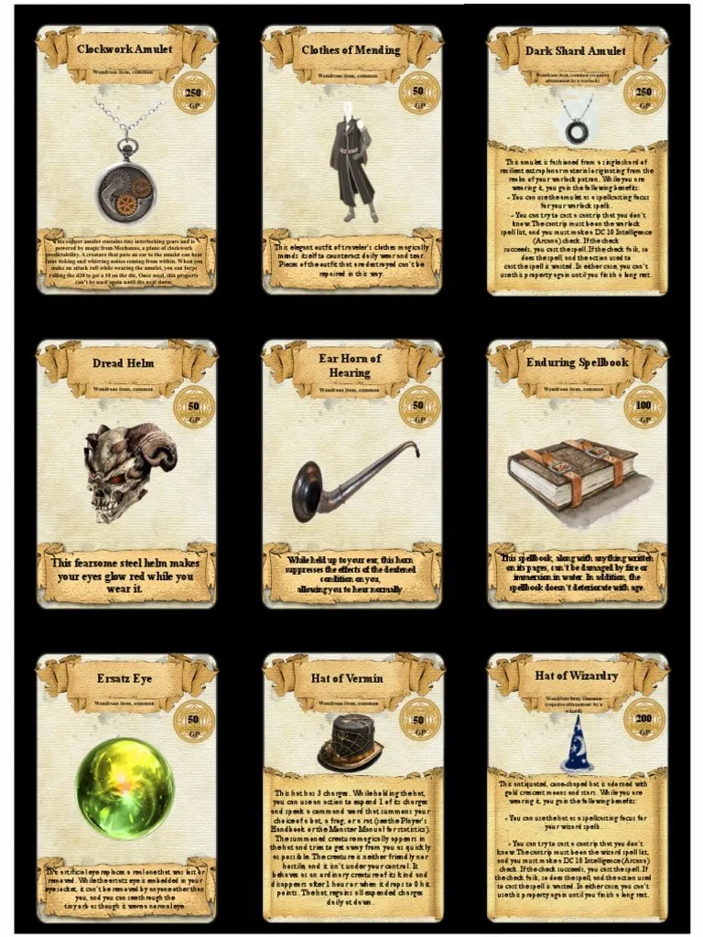
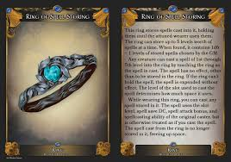
The Druid’s Prize Vault!

Slide 23
