Slide 1


Course Selection Information
2026-2027

Slide 2

Course Selection Process
  Attend a course selection information session
  Select courses
  Have parent/guardian sign the course selection sheet
  Return complete course selection sheet to their Block B class
(February 17 - 23)

Slide 3
Grade 9 | Grade 10 | Grade 11 | Grade 12
English 9 | English 10 | an English 11 | an English 12
SS 9 | SS 10 | a SS 11 or 12 | CLC
Math 9 | a Math 10 | a Math 11 or 12 | Elective
Science 9 | Science 10 | a Science 11 or 12 | Elective
a PE 9 | a PE 10 | Elective | Elective
Careers 9 | CLE 10 | Elective | Elective
Elective | Elective | Elective | Elective
Elective | Elective | Elective | Elective
 | Literary and Numeracy Assessment |  | Literary Assessment

Slide 4
Grade 9 | Grade 10 | Grade 11 | Grade 12
English 9 | English 10 | an English 11 | an English 12
Science Humaines 9 | Science Humanines et Sociales 10 | a SS 11 or 12 | CLC
Math 9 | a Math 10 | a Math 11 or 12 | FRAL 12
Sciences 9 | Science 10 | a Science 11 or 12 | Elective
a PE 9 | a PE 10 | Langue et culture de la francophonie 11 | Elective
Éducation à la Carrière 9 | Éducation au choix de carrière et de vie 10 | Communication Orale 11 | Elective
FRAL 9 | FRAL 10 | Elective | Elective
Elective | Elective | Elective | Elective
 | Literary and Numeracy Assessment |  | Literary Assessment and Évaluation de littératie de la 12e année

Slide 5
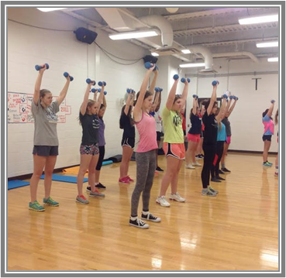
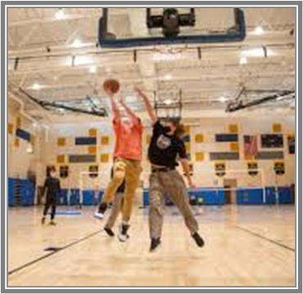
Physical and Health Education 9
Options
PHE 9
PHE 9 – Wellness
PHE 9 – Basketball
PHE 9 – Hockey Academy
PHE 9 – Soccer
PHE 9 – Volleyball

Slide 6
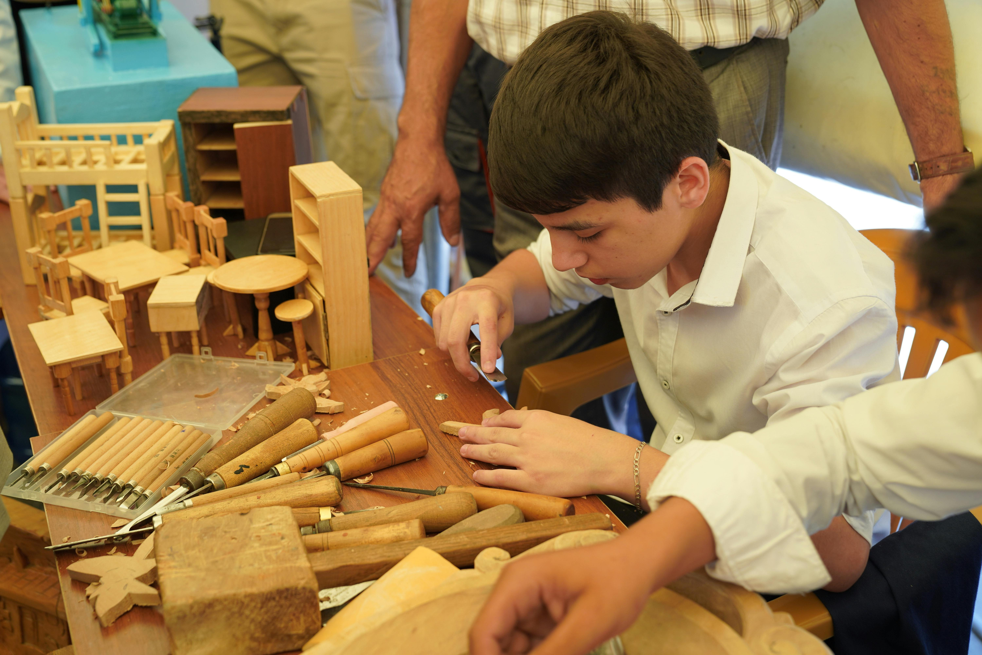

Elective Courses
  Elective courses are any courses that you choose beyond the required courses.
  They can be Arts Education or Applied Design, Skills and Technologies (ADST) courses.
  Students will choose 2 electives (French Immersion students choose 1)
  It is important to list alternative choices!!!!!

Slide 7
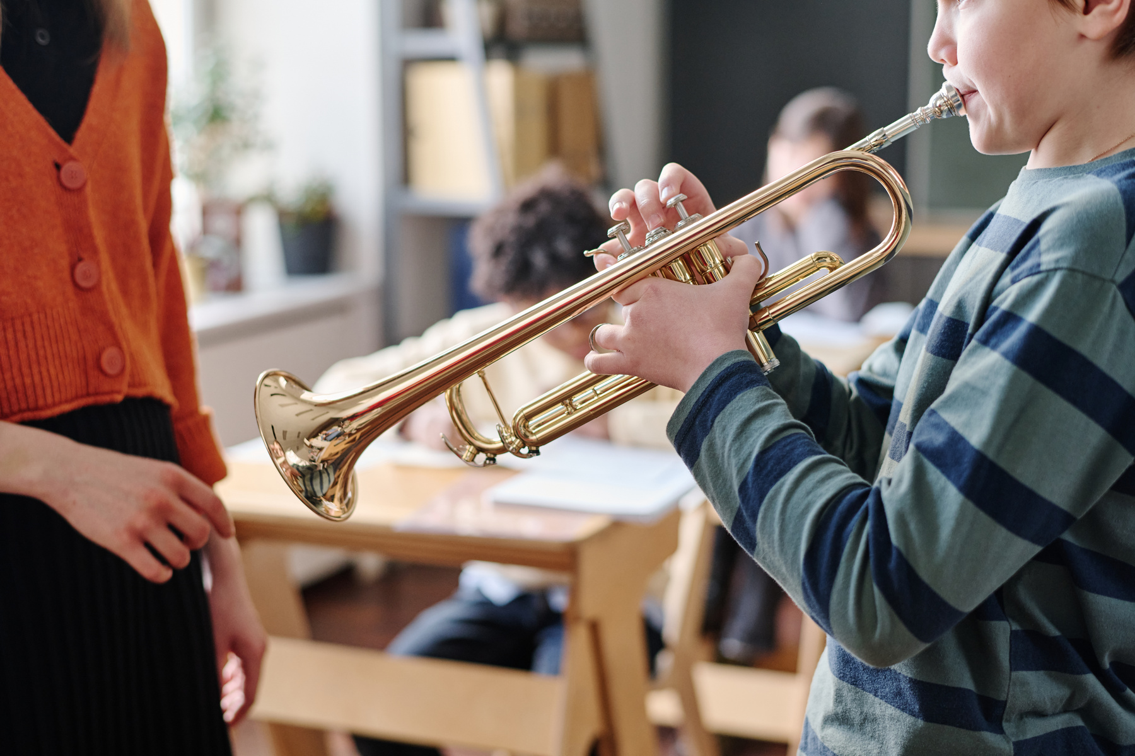



Elective Choices
ayajuthem
Concert Band
Drama
Food Studies
French
Media Arts
Metalwork
Textiles
Theatre Company
Visual Arts
Woodwork

Slide 8


Course Handbook

Slide 9

Music Choices Outside the Timetable
Chamber Choir
Jazz Band
These course are taken before or after school and are in addition to other elective choices.

Slide 10

Language Choices
ayajuthem 9
French 9

Slide 11



More Information
Counsellors
Mrs. Maxwell (A-K)
Mrs. Massullo (L-Z)
Elaine.Maxwell@sd47.bc.ca
Andrea.Massullo@sd47.bc.ca
Academic Advisor
Pam.Ellis@sd47.bc.ca
Mrs. Ellis
Career Pathways Coordinators
Mrs. Carlson
Mrs. Ellis
Kerri.Carlson@sd47.bc.ca
Pam.Ellis@sd47.bc.ca

Slide 12

Thank You

