Slide 1

3 Day Writing Plan
a suggested timeline to prepare, develop, and organize ideas for writing

Slide 2
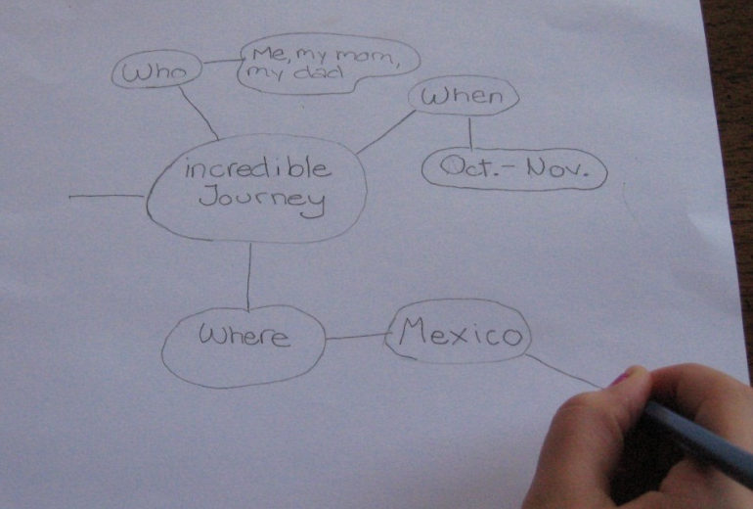
Day One
Introduce Topic: Students should write about what is important/enjoyable to them – we’ve included some suggestions for brainstorming purposes only:
Grade K-1 Perfect Pet
Grade 2-3 Superhero Skill
Grade 4-5 Special Trip
Grade 6-7 Incredible Journey
Share a personal story with students to give an
example of choosing a topic.
Show pictures/visuals if you have them.
Have students share their ideas with someone
else – a sibling or a parent is great!
Teach or review the concept of webbing: “a graphic
organizer that allows visual thinkers to arrange their ideas”
(see right and appendix 1 - Sample Web).
Have students create a word web with their topic and ideas they’d
like to include in their writing piece.
Notes:
Take out topic titles so the students can write about what is important/enjoyable to them.

Slide 3
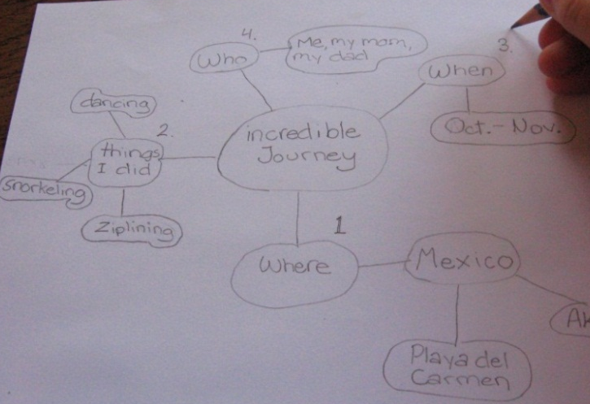
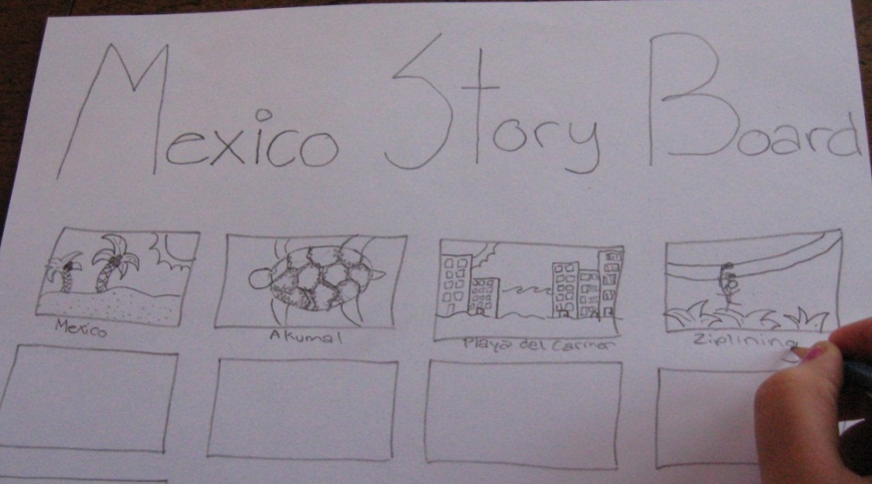
Day Two
Have students:
Revisit their topic – it’s not too late to change their minds!
Add numbers to the web to help organize and expand on the
ideas (see below and appendix 2).
Create a storyboard to experiment with visualizing their writing ideas in both picture and linear form (see below and appendix 3).
Share their storyboard with someone else – get feedback!
Add captions – a single word/short phrase is enough for each picture.
Numbered web
Storyboard
Notes:
Choose to do what works best for the student:
a) story web, storyboard, and outline
b) web
c) storyboard
d) outline

Slide 4
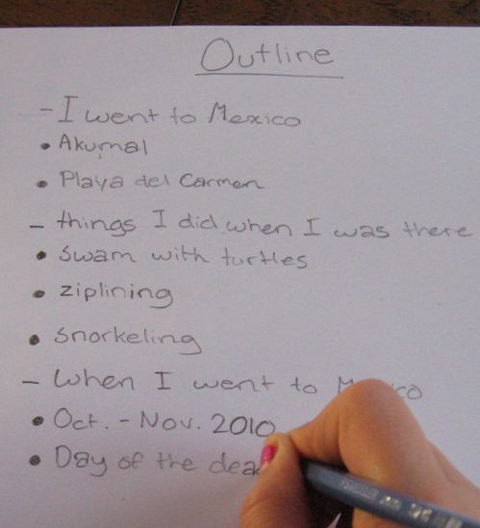
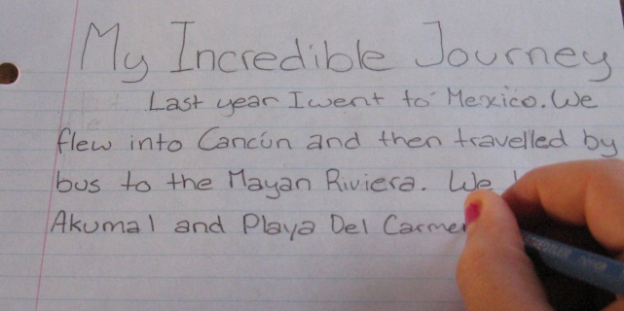
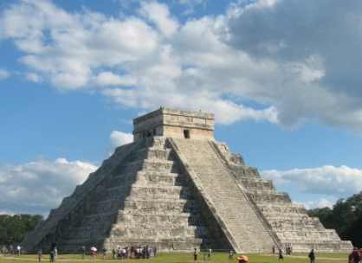
Day Three
Have students write, review and edit in one session by:
Reviewing ideas on numbered web, and in the story board.
Writing outline using the big ideas from the web and
storyboard in list form (see right and appendix 4).
Writing the ideas from the outline in complete sentences.
Adding an introduction and conclusion (see appendix 5 & 6).
Reviewing sentences, making sure ideas are clear.
Editing - trying to vary the length of sentences, use interesting and exciting words (see word banks in appendix 7 and 8), and
make sure the main point has been clearly conveyed.
Notes:
Review their choice of planning technique and begin writing.

Slide 5


Sample Web
Appendix 1
Incredible journey
Who
What
Where
When
The number of bubbles will depend on the number of ideas you come up with

Slide 6
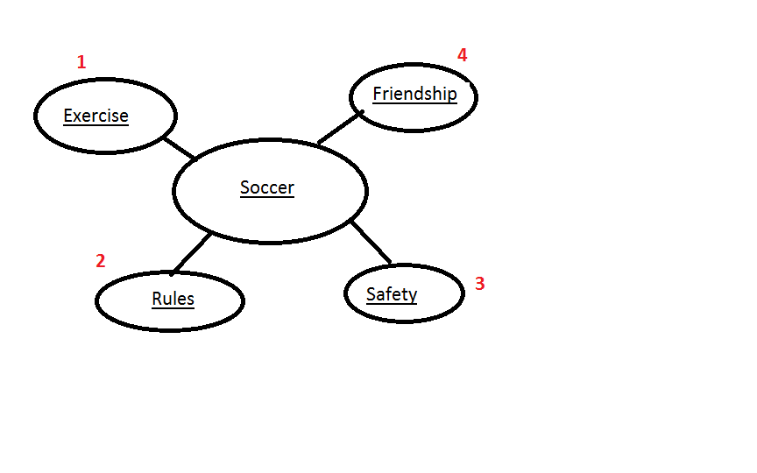
Sample Numbered Web
Appendix 2

Slide 7
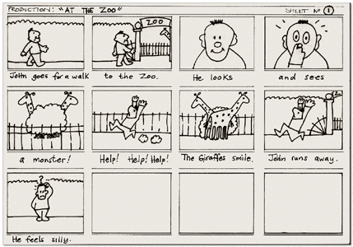
Example Story Board
Appendix 3

Slide 8
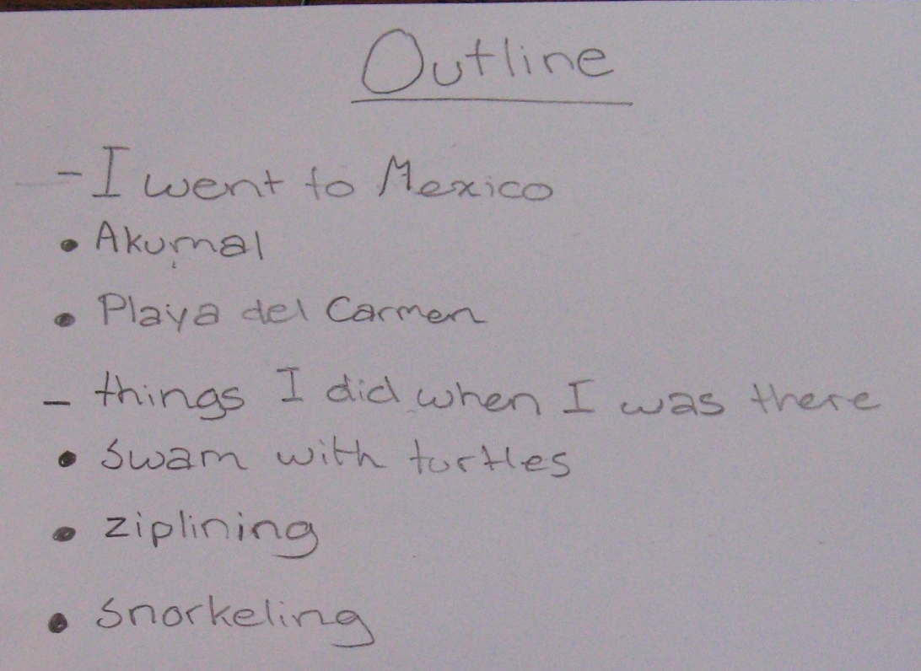
Sample Outline page 1/2
Appendix 4
Grade 6-7 Topic: Incredible Journey
Paragraph 1
Example Topic:
“Places I went to in Mexico.”
Details:
What were the names?
What did you like about the places?
What did you see/hear/smell?
Paragraph 2
Example Topic:
“Things I did when I was there.”
Details:
What happened?
Where did it happen?
Would you do the activities again?
Notes:
Sample outline is good but I would add word bank lists for things we want them to include or ideas for their writing such as:
‘said is dead’ list, touch word list, sight word list, sound word list, taste word list, emotions list, setting word list, character list, adjective list, and adverb list.
When the student is stuck he/she would have a place to look for ideas. It may seem to hand feed them but I think it would open their minds to new possibilities. I think this may help to move the student from a ‘3’ to a ‘4’ and even those below.
As well, add a new page that includes a child friendly rubric of the quick scale.

Slide 9

Sample Outline page 2/2
Appendix 4 cont.
Paragraph 3
Example Topic:
“When I went to Mexico”
Details:
What were the travel dates?
Why did you go then?
What holidays/festivals did you attend?

Slide 10

Sample Introduction
Appendix 5
To write an introduction, have students:
Tell their audience what they are going to be telling them about!
State their topic, and the subjects of their three paragraphs.
For example:
My incredible journey was a trip to Mexico. I went to several places in an area called the Mayan Riviera. We did lots of exciting activities, and we were able to experience a Mexican holiday called, “Dia de los Muertos” or “Day of the Dead”. This essay will give you the highlights of my journey.

Slide 11
Sample Conclusion
Appendix 6
  To write a conclusion, have students:
Tell their audience what they have told them! Re-state their ideas and make sure they are clear to the reader.
Re-state their topic and the subjects of their 3 paragraphs, in slightly different words.
For example:
In conclusion, I had a wonderful holiday in Mexico! I visited many different places, including Akumal. I did lots of new things – mostly in the super warm ocean; and I experienced a Mexican holiday. Going to Mexico changed my life.

