Slide 1
Back In The Day
Ideas to Support a Visit to the Texada Museum’s One-Room School House and Teacherage Exhibit

Slide 2
Suggested Activities
Ask students to dress up in period outfits for the day (see attached instructions).
Conduct research ahead of time to see what school was like 100 or so years ago in Canada. https://www.cbc.ca/kidscbc2/the-feed/what-was-school-like-150-years-ago
Find out what it would be like to be a rural, one-room school house teacher at the turn of the last century. https://www.thecanadianencyclopedia.ca/en/article/rural-teachers-in-canada
Have students interview an older friend or family member about their school experience – have them turn the interview into a simple paragraph or presentation (see sample interview attached).
Have students do a “Then and Now” comparison between school materials used 100+ years ago and those used in modern classrooms. Presentation could involve students’ sketches or photography.
Ask students to research playground games played by students a century or so ago. They can write the rules, make requisite materials, and/or teach the game to a group of students.

Slide 3
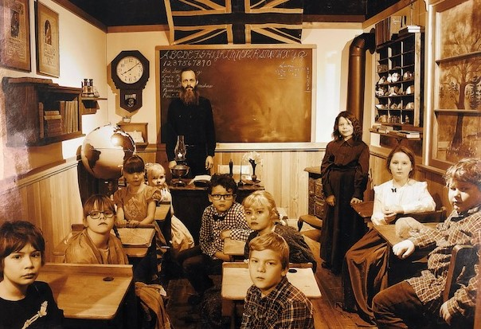
Back In The Day: Dressing Up for School in 1910
Dressing up in period clothing for a trip to see Texada Museum’s One-Room School-House and Teacherage Exhibit can
be fairly simple. Below are some suggestions:
Boys: Girls:
Flat cap Braids
Button-up shirt Large hair bows
Bowtie Full skirt below the knee
Suspenders Long sleeved blouse
Slacks Knee socks
Overalls Plain black or brown shoes
Plain black or brown shoes Pinafore dress or apron

Slide 4
Back In The Day: An Interview
Name: ____________________________________
Instructions: Choose an older family friend or relative to interview.
Sample Interview Questions:
In what year did you begin elementary school?
What was the name of your elementary school and where was it located?
What did your classroom look like?
What did you wear to school?
What did you pack your lunch in, and what food did you bring?
What classroom and school rules do you remember?
What would happen if a student broke the rules at school?
How did you get to school? Please describe the experience.
What games did you play at school?
Who was your favourite teacher, and why?
What learning tools did you use?
What was your favourite subject, and why?
What books did you read at school?

