Slide 1
Grade 9 BIOLOGY
Sustainable Ecosystems

Slide 2
Ecology is the scientific study of the abundance and distribution of organisms, and of their interactions with their environment
Oikos = house
Logos = to study

Slide 3
Ecology uses the scientific method of hypotheses and deductions.
Good hypotheses generate predictions that can be tested.
Experiments are designed to test the hypotheses.
If the data gathered does not support the hypothesis, it is refuted or falsified.
An experiment cannot prove a hypothesis to be true – rather they become strong hypotheses if multiple experiments fail to refute them.

Slide 4
Robert T. Paine
Zoologist Robert T. Paine, who coined the term "keystone species," had an unorthodox way of doing his work.
It was unorthodox at the time because most ecologists simply observed and measured factors in nature and tried to make conclusions from these.

Slide 5
Paine’s experiment
Instead of just observing the habitat of the Pisaster ochraceus sea star, Paine experimented by changing the habitat.
Paine and his students from the University of Washington spent 25 years removing the starfish from a tidal area on the coast of Tatoosh Island, Washington, in order to see what happened to other species when they were gone.

Slide 6
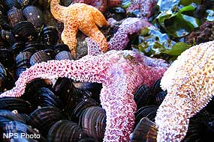
The sea stars are a major predator for mussels on Tatoosh Island.
With the sea stars gone, mussels took over the area and crowded out other species.
In this ecosystem, the sea star was the keystone species.

Slide 7
Ecology is exciting!
Ecology has a long history of being a historical science, and has only started to become an experimental science in the last 50 - 60 years.
Many old ideas have not had a chance to be tested thoroughly
This makes ecology an exciting field of study, because new discoveries can have an enormous impact

Slide 8
Experimental Lakes Area
World renowned Canadian institution
Only place in the world capable of doing long-term, whole-ecosystem experiments
Have studied such topics as:
Effects of synthetic hormones on fish
Impacts of flooding soils on mercury contamination of fish
How changing nutrient balance in freshwater lakes affect blooms of toxic algae
How acid rain affects lake ecosystems

Slide 9
Environment
What is meant when we say that organisms interact with their “environment”?
The environment includes both biotic and abiotic components.
Biotic components are the living aspects of the environment – other members of the same species and members of other species.

Slide 10
Examples of biotic factors
Mice must be constantly vigilant to avoid predation by owls and snakes
Mice must also compete with other mice for resources such as habitat space, food and water, and access to potential mates

Slide 11
Abiotic factors
Abiotic components are the non-living factors or conditions which are unique to the ecosystem.
These are usually conditions such as the amount of rainfall, sunlight levels, wind speed, soil temperature, nutrient levels, oxygen concentration, type of substrate

Slide 12
Biotic and abiotic factors
Ecosystem | Abiotic factors | Biotic factors
Coniferous forest | Long cold winter season Warm summers Moderate rainfall Much precipitation falls as snow Snow insulates and protects ground species Short growing season | Few species Dominated by black spruice forests and bogs Black bear, red squirrels, moose Many biting flies - blackflies, mosquitoes, horseflies, deerflies
Coral reef | Water temperature from 25–31˚C Water depth from 0 – 30 m Usually occur in tropical latitudes Substrate high in limestone from bodies of coral | High variety of marine life – corals, sponges, fish, crabs, urchins Organisms sensitive to changes in temperature and acidity
Rotting log | Moist environment Low light levels Temporary ecosystem – lasting less than a decade | Bacteria, fungi, lichens, moss, some ferns Beetles, insect larvae Provides cover for small vertebrates like salamanders and skinks

Slide 13
Levels of organization
Depending on the question asked, an ecologist might investigate at one or more of the following levels:
Individuals
Populations
Communities
Ecosystems

Slide 14
Individuals
A single member of a species
Sometimes this is difficult to define
Eg: a colony of quaking Aspen (Populus tremuloides) in Utah has been determined to be part of a single living organism, with an interconnected root system. This makes it the heaviest organism on the planet, estimated at 6000 tonnes. It is also likely the oldest organism on the planet, approximately 80,000 years old.
Eg: similarly, the honey mushroom colony is known to cover 8.9 km² of forest in Oregon, making it the largest organism on the earth by area
Q: How does a cave cricket find its way in and out of it’s dark cave when it comes out to forage for food?

Slide 15
Populations
Groups of the same species living in one area
a herd of caribou
a flock of Canada geese
the E. coli bacteria living in a person’s gut
all of the smallmouth bass living in a lake
They may compete for resources, and are also more likely to combine their genes during reproduction than with members of other populations

Slide 16
Populations
Population ecologists ask questions at this level
Often the questions are about abundance, density, population growth and limits on growth
Q: How does deforestation in Costa Rica affect the maximum number and the nesting success of migrating songbirds?

Slide 17
Communities
Groups of different species living in the same area.
Different species have different roles or ‘functions’ in a community
Eg: some act as producers, others are consumers and still others are decomposers

Slide 18
Communities
Imagine a herd of caribou
Now include the two species of grass that it feeds on in the tundra
Now picture the many other species of sedges and grasses that they trample in the process of grazing
Now imagine the species of beetles that feed on the same species of grasses, the soil microorganisms, the ticks that live on the hide of the caribou, and the birds that feed on those ticks, and the beetles that feed on the dung of the caribou
This is a very simplified picture of a tundra community
Q: How does the presence of (or absence) of a tick fungus affect the survival of a population of caribou?

Slide 19
Ecosystems
Ecosystems are assemblages of interacting communitites in the same general area, as well as the abiotic factors that are important for sustaining life.
Ecosystems can be nested within other ecosystems.
The size of an ecosystem can be as large as a national park, or as small as a rotting log.

Slide 20
An Ecosytem ecologist might ask:
What role do insect populations play in the health of salmon, bear and coniferous trees in coastal ecosystems.
OR
What role do the nutrients in bat guano (feces) play in the support of nonphotosynthetic ecosystems in caves?

Slide 21
Sustainability
Most natural ecosystems are sustainable
This means they have the ability to maintain natural ecological conditions or processes without interruption, weakening, or loss of value indefinitely
Artificial ecosystems are usually not sustainable
They require input of energy to maintain the biotic and abiotic factors

Slide 22
Energy in Ecosytems
All organisms need energy to survive and to function – energy is ability to do work, such as grow, repair, search for mates, search for food
Ultimately, all of the energy on earth came from the sun!
But only a small part of the sun’s energy is actually used directly by organisms.
30% is reflected by clouds back into space
The other 70% is absorbed by the lithosphere, atmosphere and hydropshere
This is important because it warms the earth, and produces weather and climate patterns

Slide 23
Energy in Ecosystems
Only a very small percentage of that 70% is used for photosynthesis: ~0.023%
Producers convert the sun’s energy into chemical potential energy - into molecules of sugar in a process called photosynthesis
Both producers and consumers break these sugars down using their mitochondria in a process called cellular respiration
This allows them to use the energy stored in the sugars to grow and reproduce

Slide 24
Photosynthesis and Cell Respiration
Photosynthesis:
carbon dioxide + water sugar + oxygen
Cell respiration:
sugar + oxygen carbon dioxide + water

Slide 25
Energy flow in a food chain
Consider the following food chain:
Pine cone (seeds) red squirrel weasel goshawk
In this food chain, some of the chemical energy stored in the pine cone is passed through the red squirrel on into the weasel and finally to the goshawk.
In a food chain, only about 10% of the energy gained and used by one level is passed on to the next
Of all of the energy the pine tree has absorbed over its lifetime, only some of it is now stored in the tissues of the tree – most of it has been converted into heat and can never be used by other organisms

Slide 26
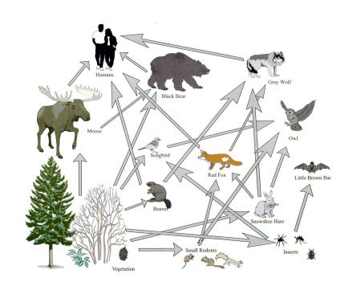
Food Webs
Food chains do not exist in nature – instead they are part of a much larger food web – even this example is greatly simplified

Slide 27
Trophic Levels

Slide 28
Food Webs

Slide 29
Trophic Levels
Top consumers
Tertiary consumers
Secondary consumers
Primary consumers
Primary producers
0.01%
0.1%
1%
10%
100%
~90% energy lost as heat
~90% energy lost as heat
~90% energy lost as heat
~90% energy lost as heat
~90% energy lost as heat

Slide 30
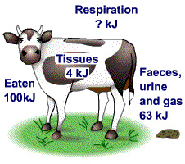
Energy is lost at each level
This bull has eaten 100 kJ of stored energy in the form of grass, and excreted 63 kJ in the form of feces, urine and gas. The energy stored in its body tissues is 4 kJ. So how much has been used up in respiration?
The energy released by respiration = 100 - 63 - 4 = 33 kJ
Only 4 kJ of the original energy available to the bullock is available to the next stage, which might be humans. The efficiency of this energy transfer is:
efficiency = ⁴⁄₁₀₀ × 100 = 4%

Slide 31
What should we be eating?

Slide 32
Pyramid of energy

Slide 33
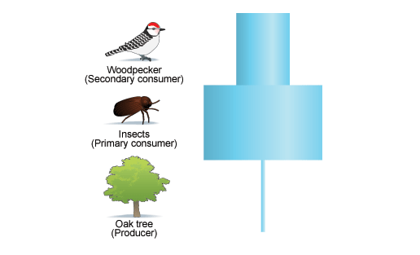
Pyramid of numbers

Slide 34
Pyramids

Slide 35
Cycling of Matter

Slide 36
Carbon Cycle

Slide 41
Nitrogen Cycle

Slide 42
Phosphorus Cycle

Slide 43
Biotic and Abiotic Factors
Abiotic factors will determine which species can live in an ecosystem
e.g.: cactus will thrive in desert, but maple trees will not
All species have a range of tolerance
Outside this range of an abiotic factor such as temperature, there is a zone of stress
Outside this range, there is a zone of intolerance

Slide 44
Range of Tolerance

Slide 45
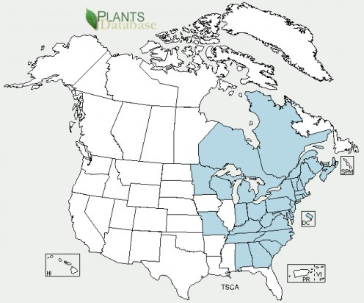
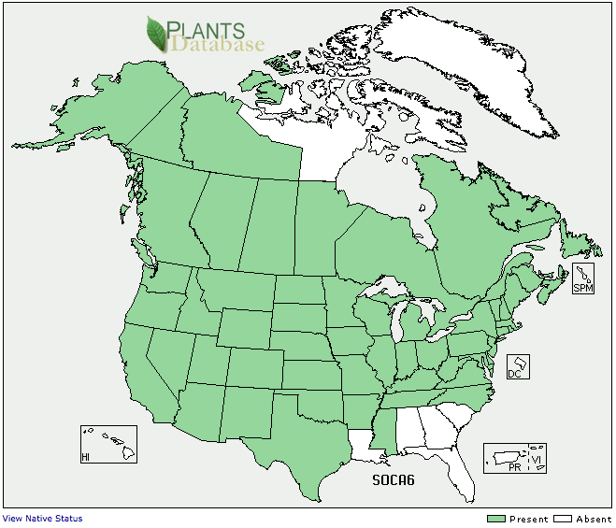
Distribution of a species
Each ecosystem has a set of abiotic factors that allow certain species to live

Slide 46
Biotic Factors
The species that live or colonize an area can determine the characteristics of that area as well
Grass plants produce no shade, but oak trees do
Lichen can gradually erode rock to form soil, changing the types of plants that can live in an area.

Slide 47
Carrying Capacity
The upper limit of organisms that an ecosystem can support for an unlimited amount of time
As population size increases, competition for resources increases
Individuals become more susceptible to predation and disease
Carrying capacity can change because environmental conditions can change

Slide 48
Carrying Capacity

Slide 49
Biotic Interactions
Competition: between species, or within species
Predation: lynx-hare, owl-vole
Symbiosis:
Parasitism: brown cowbird
Mutualism: lichen – algae and fungus
Commensalism: caribou and mice

Slide 50
Terrestrial Ecosystems
A biome is a large geographic area that has a characteristic climate (temperature and precipitation) and set of biotic and abiotic features
In Canada, there are four major biomes
Temperate deciduous forest
Boreal forest
Grassland
Mountain forest
Tundra

Slide 51
Aquatic Ecosystems
Water covers more than two-thirds of our planet
97% of the water is salt water
Freshwater is available in rivers, streams, lakes, and groundwater.
Some is stored as snow or ice – these often act as the source of freshwater rivers

Slide 52
Aquatic Communities
Ocean
Pelagic – light penetrates top few meters
Abyssal – light is absent
Continental Shelf
Inter-tidal – hear shore – many specially adapted species
Coral reefs – distinctive communities dominated by coral, algae and plankton
Freshwater
Lakes
Rivers
Wetlands – swamps, marshes, bogs and fens

Slide 53
Plants and animals in aquatic ecosystems have adapted to abiotic conditions such as:
Less oxygen available, which limits activity
Water is 800 times denser than air, making it difficult to move through
Dramatic pressure changes , making it difficult for species to travel to different depths

Slide 54
Abiotic Factors in Lakes
Amount of light available
Water temperature
Oxygen levels
Lakes are divided into zones which are characterized by these abiotic factors.
Abiotic factors dictate the organisms that will reside in each zone.

Slide 55
Types of Lakes
Oligotrophic – deep and cold, low nutrient levels, producer populations are limited, water very clear. (Lake Superior is 200 m deep)
Eutrophic – shallow and warm, high nutrient content, many photosynthetic organisms, water is murky.

Slide 56
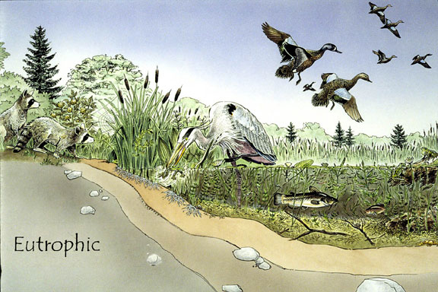

Slide 57
Oligotrophic lakes gradually become eutrophic.
Eutrophic lakes become shallow over time and result in dry land.
The evolution from a oligotrophic lake to dry land is called eutrophication.
This evolutionary change may take hundreds to thousands of years.
Human waste can speed up eutrophication.
This fact was discovered by the ELA in the 1970s with some controlled experiments

Slide 58
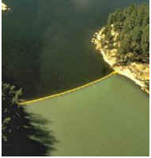
Eutrophication
The two basins of this lake were separated by a plastic curtain. The lower basin received additions of carbon, nitrogen and phosphorus; the upper basin received carbon and nitrogen only. The bright green colour is from a surface scum of algae resulting from phosphorus additions.

Slide 59
Watershed
The entire interconnected set of rivers, lakes and groundwater in a large area
The watershed that serves the area where you live is called the Etobicoke Creek Watershed
Formed by the Brampton Esker - a long, winding ridge of sand and gravel deposited by glacial meltwaters as glaciers retreated
The esker rises north of Mayfield Road and runs between Hurontario Street and Kennedy Road south to Queen Street.

Slide 60
Ecosystem Services
Ecosystem services are the benefits experienced by species (including humans) that are provided by sustainable ecosystems. Examples of services include:
atmospheric gas supply
climate regulation
water supply
food production
raw materials
waste treatment
soil erosion control
nutrient recycling

Slide 61
Succession
Gradual and predictable changes in the composition of biotic and abiotic factors following a disturbance
Primary succession – occurs on bare soil or rock – such as after a volcanic eruption
Secondary succession – following a disturbance that does not necessarily destroy the community – such as a road cut or forest fire

Slide 62
Biodiversity
The variety of life in an ecosystem
Not only variety of different species, but also genetic variation within a species
Compare: a naturally-occurring forest with a tree farm
Threats to biodiversity include: habitat destruction, climate change, air and water pollution, overhunting and overfishing, introduction of exotic species

Slide 63
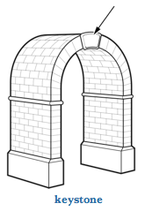
Keystone species
One species in an ecosystem that links together many different food chains
Can be useful in determining the health of an ecosystem
E.g.: the black fly in Ontario

Slide 64
Species at Risk
When population levels fall below a certain level, there are ecological consequences
Special concern
Threatened
Endangered
Extirpated
Extinct

Slide 65
Habitat Loss
Not only does the area of a habitat loss matter, sometimes the fragmentation of a large area can reduce sustainability
Habitat loss and fragmentation is second only to climate change as the most serious threat to sustainability of ecosystems
Songbirds native to Ontario migrate to south and central America in the winter – as these areas are deforested more each year, the birds have less and less suitable nesting grounds when they finish their migration

Slide 66
Habitat Fragmentation
Factors that improve the sustainability of habitat fragments
Factor | Poorer Option | Better Option | Reason
size |  |  | Large blocks support large more stable populations and communities
number |  |  | One large area is better because there is less outside influence
proximity |  |  | The closer fragments are, the greater chance organisms will be able to use the entire area
connectedness |  |  | Wildlife corridors permit migration between blocks
integrity |  |  | Access by road and trails can increase pollution, hunting and fishing

Slide 67
Introduction of Exotic Species
A species that is introduced (purposefully or accidentally) which negatively impacts the natural ecosystem
Ontario examples:
Asian Carp
Zebra mussel
Asian Long-horned Beetle
Starlings
Purple loosestrife
Lamprey

Slide 68
Controlling Exotic Species
Chemical control
larvicides and pesticides
may kill non-target species
add harmful chemicals to the environment that may last for many years
Mechanical Control
physical barriers
removal by hand
Biological control
intentional introduction of a predator species which will target only the invasive species
not likely to eradicate introduced species, only reduce their numbers

Slide 69
Pollution
Release of any toxic material into the environment – air, water, or ground
Acid precipitation – sulfur dioxide, nitrogen oxides released combines with water vapour to form acid – this falls as rain or snow
Affects soil and water, productivity of forests and lakes and ocean ecosystems, buildings and bridges that are made of limestone

Slide 70
Water Pollution
Oil spills and leaks occur hundreds of times each year in Canada
Many are considered small (measured in hundreds of barrels of oil)
Large oil spills like the Exxon Valdez or the British Petroleum’s Deep Water Horizon are more dramatic
Both large and small spills have long-lasting effects on the environment

Slide 71
Forestry Practices
Natural forests can maintain themselves without human intervention
If we use them as a resource, we must do it in a sustainable way – so that the trees do not limit habitat and allow for regeneration of cut areas
Three common types of forestry methods:
Clear-cutting
Shelterwood cutting
Selective cutting

Slide 72
Soil

Slide 73
Soil Characteristics
Besides a mixture of minerals, nutrients, and decomposing organic matter, soil is also composed of many living things including billions of microscopic organisms
Bacteria – both harmful (like tetanus) and helpful (nitrogen-fixing bacteria)
Fungi – mycorrhizal fungi surrond root hairs of plants and help deliver water and nutrients to the plant root

Slide 74
Soil Characteristics
Nutrient content
Compaction and air spaces
Water-holding capacity
Acidity (pH level)
Soil differs in these factors depending on how much humus, silt, sand, and clay it contains

Slide 75
Managing Soil Nutrients
When a food crop grows, the nutrients in the soild are taken up by the plants and locked in their cells and tissues
When the crop is harvested, the nutrients it contains (carbon, nitrogen, phosphorus) are removed from that field and so need to be replaced or the soil will not be fertile enough to grow more crops

Slide 76
Fertilizers
Natural - plant and animal waste
Synthetic – usually contains some mixture of nitrogen, phosphorus and potassium – increased crop yields dramatically in the 1960s when they were first introduced
Problems with concentrated fertilizers:
Leaching into groundwater
Stress out soil organisms
Soil becomes dependent on fertilizer
Soil becomes susceptible to erosion

Slide 77
Irrigation and drainage
Diverting water from an aquatic ecosystem to a farmland is necessary if precipitation is not reliable
This can have negative consequences
Wetlands and rivers can be harmed by too much water being diverted for agriculture

Slide 78
Alternative Farming Practices
To reduce the impact of farming
No-tillage – ground is left undisturbed after harvest – stumps of plants are decomposed to add nutrients to soil, reduces compaction and water loss
Crop rotation – plots are not farmed with the same crop every year – alternating between corn soybean and wheat – reduces need for fertilizers
Crop selection – choosing crops best suited to the growing location – for example drought resistant or heat-tolerant plants would do better in hot dry areas

Slide 79
Pests and Poisons
A farm is a monoculture – only one species is supported
This maximizes food production, but is unnatural
A lot of effort is made to reduce loss from pests such as fungus, insects, and competition from other weeds
Pesticides are commonly used, which work by causing physical or biological harm to a pest

Slide 80
Problems with Pesticides
They are sometimes not specific and can affect non-target species
Pests often become resistant to pesticides and so new ones constantly need to be developed
Bioamplification – when toxins are absorbed by organisms at greater levels than they are excreted

Slide 81
Bioaccumulation
Pollutants (especially ones that are fat-soluble) increase in concentration in each trophic level – DDT, methyl mercury, persistent organic pollutants (POPs)
Even when released in very low concentrations into the environment, with each step up the food chain pollutants are not excreted because they are locked in the fat tissues
Therefore these get passed on to the next trophic level in ever greater quantities

Slide 82
Bioaccumulation

Slide 83
http://www.uic.edu/classes/bios/bios101/ecologie/sld029.htm
http://www.bbc.co.uk/schools/gcsebitesize/science/add_aqa/foodchains/foodchains3.shtml
http://kentsimmons.uwinnipeg.ca/16cm05/1116/16ecosys.htm
Robert T. Paine
http://www.jstor.org/discover/10.2307/2459379?uid=3739448&uid=2&uid=3737720&uid=4&sid=21102151015881

