Slide 1
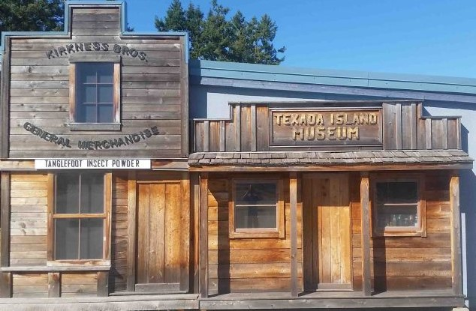
Texada Museum Scavenger Hunt
Look. Listen. Learn

Slide 2
Texada Museum Scavenger Hunt: Look. Listen. Learn.
Name(s): _____________________________________________________
Circle the correct answer………
1. Whose doctor’s bag is on display in the museum?
a) Doctor McKenzie b) Doctor Black c) Doctor Garner
2. What did customers have to pay for a pack of clothes pegs at Mr. Kempe’s store?
a) $1.50 b) $ .99 c) $ .49
3. What two tools did First Nations fishers use for halibut fishing?
a) Flasher & Hoochie b) Stone sinker & Bone hook c) Bone hook & Fish eggs
4. In what year did the Cheslakee sink?
a) 1979 b) 1913 c) 1893
5. What was the nickname given to the Upper Gillies Bay Highroad?
a) Germantown b) Swedetown c) Way Out Thereville
6. The one-room school in Blubber Bay had a beautiful bell tower. What ship did the bell come from originally?
The Empress of Japan b) The Queen of Burnaby c) Titanic
7. Name two European explorers who charted BC’s Inside Passage.
a) Valdes & Vancouver b) Powell & Gillies c) Stevens & Pepper

Slide 3
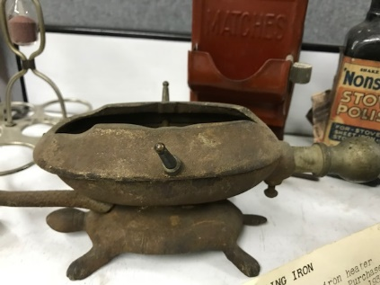
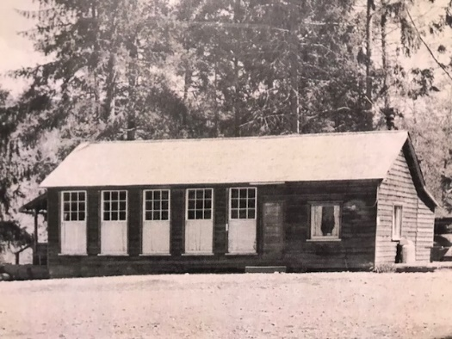
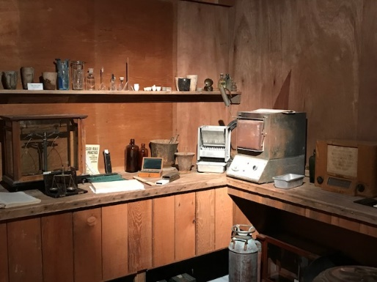
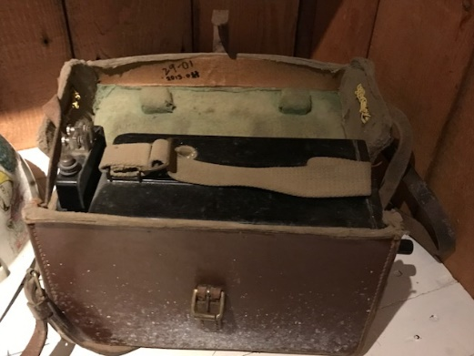
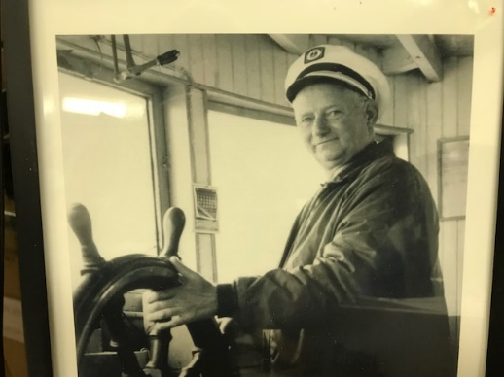
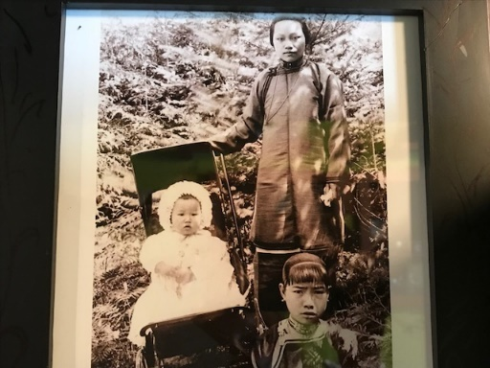
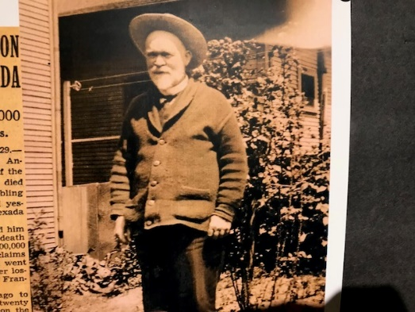
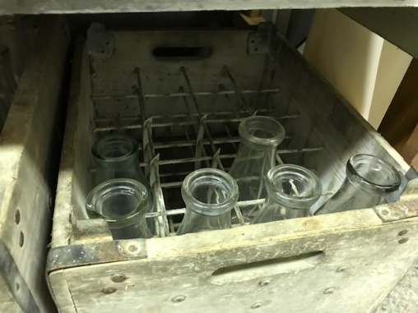
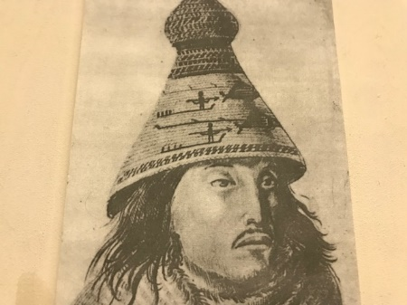
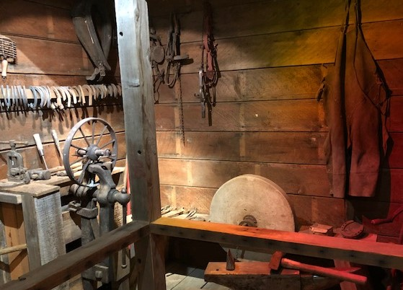
8. In what building was the very first school on Texada opened?
The Honeymoon cottage b) The Elks’ Hall c) The Grand Hotel
9. The one-room school house teacher lived:
In a hotel room b) With a farming family c) In the teacherage
10. Students in the one-room school house had to:
Bring their own computers b) Pack firewood c) Stand all day
Identify the person, place or object…….

